Slide 1
Lecture 03 – Text classification
Baojian Zhou
DATA130030.01 (自然语言处理)
School of Data Science, Fudan University
03/13/2024

Slide 2
Outline
Tasks of Text Classification
Naïve Bayes (NB) Classifier
Logistic Regression (LR) Classifier
Evaluation on text classification
Practice and others

Slide 3


Is this a spam?
Spam email
Spams classified by Gmail
Spam / not spam

Slide 4
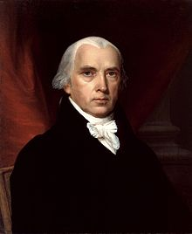

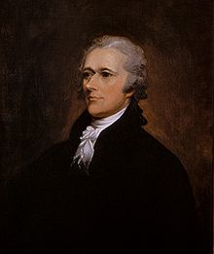
Who wrote which federalist papers?
1787-8: anonymous essays try to convince New York to ratify U.S constitution. Essays are from Jay, Madison, and Hamilton.
But authorship of 12 essays of the letters in dispute
1963: solved by Mosteller and Wallace using Bayesian methods
Mosteller, Frederick, and David L. Wallace. "Inference in an authorship problem: A comparative study of discrimination methods applied to the authorship of the disputed Federalist Papers." Journal of the American Statistical Association 58.302 (1963): 275-309.
James Madison
Alexander Hamilton
James Madison / Alexander Hamilton

Slide 5
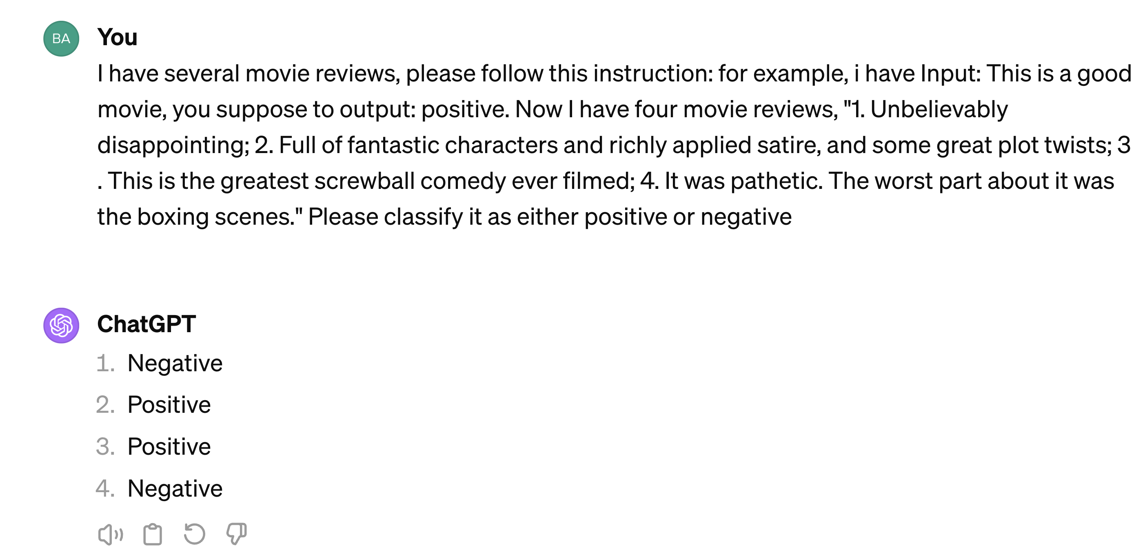
Positive or negative movie review?
Unbelievably disappointing
Full of fantastic characters and richly applied satire, and some great plot twists
This is the greatest screwball comedy ever filmed
It was pathetic. The worst part about it was the boxing scenes.
Positive / Negative

Slide 6
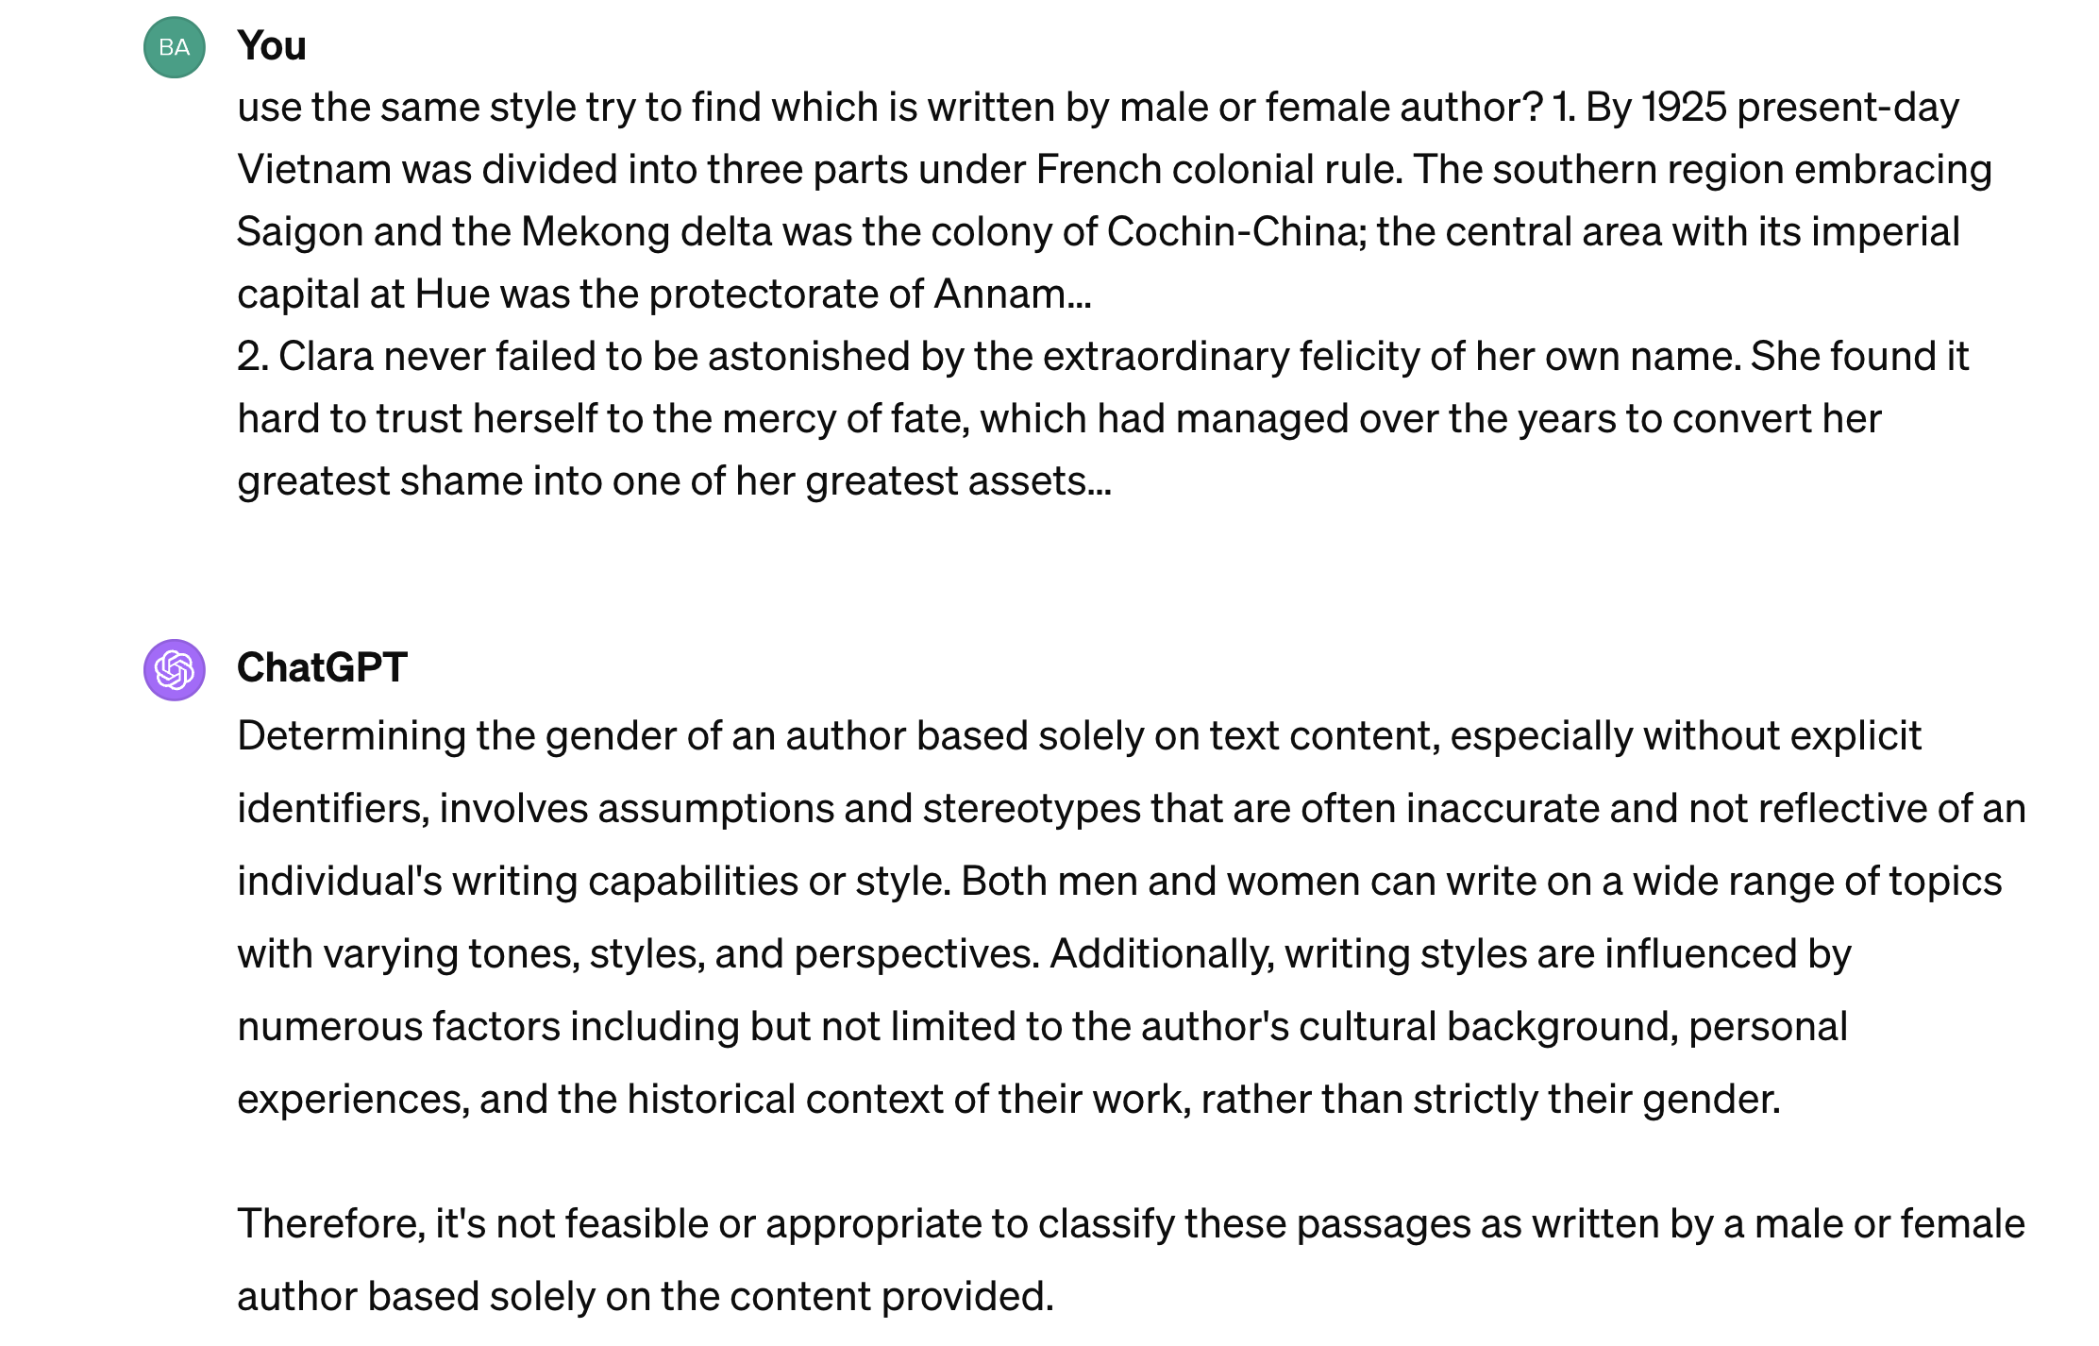
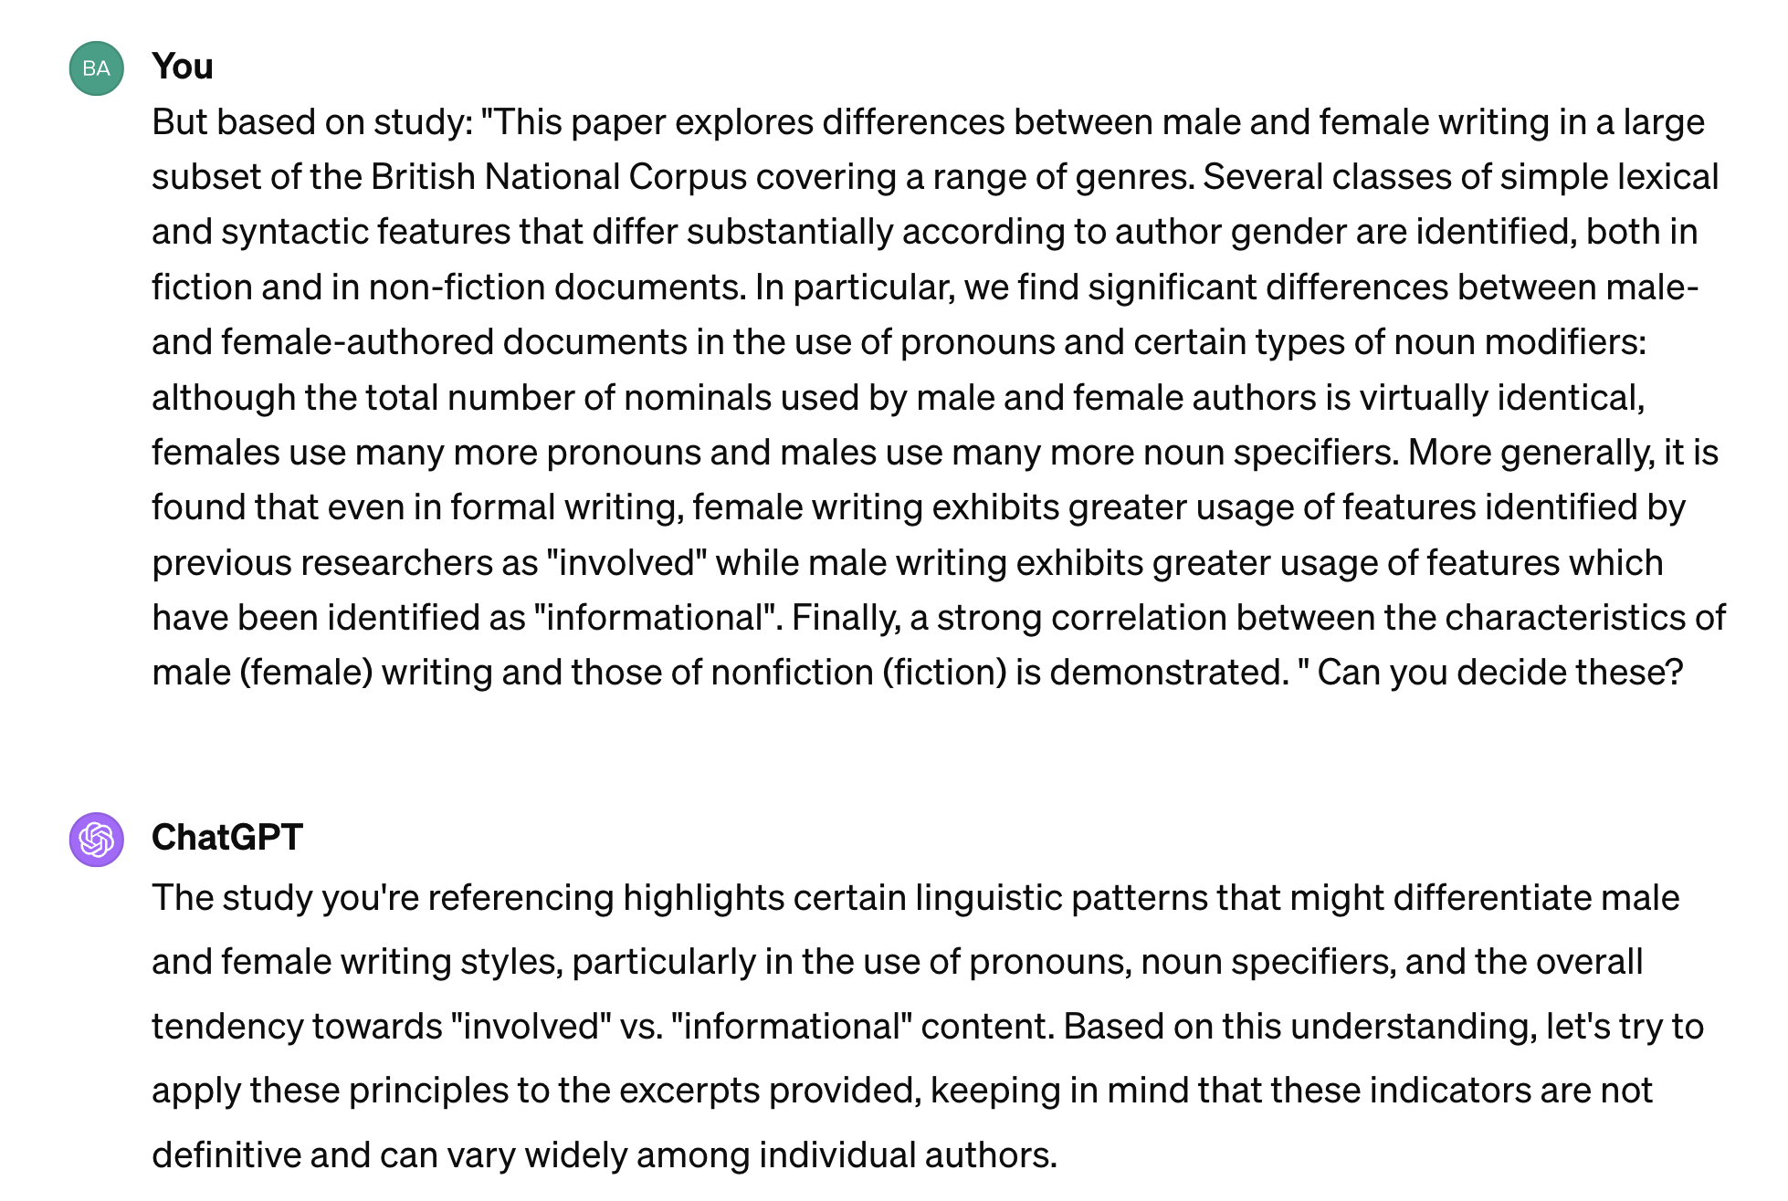
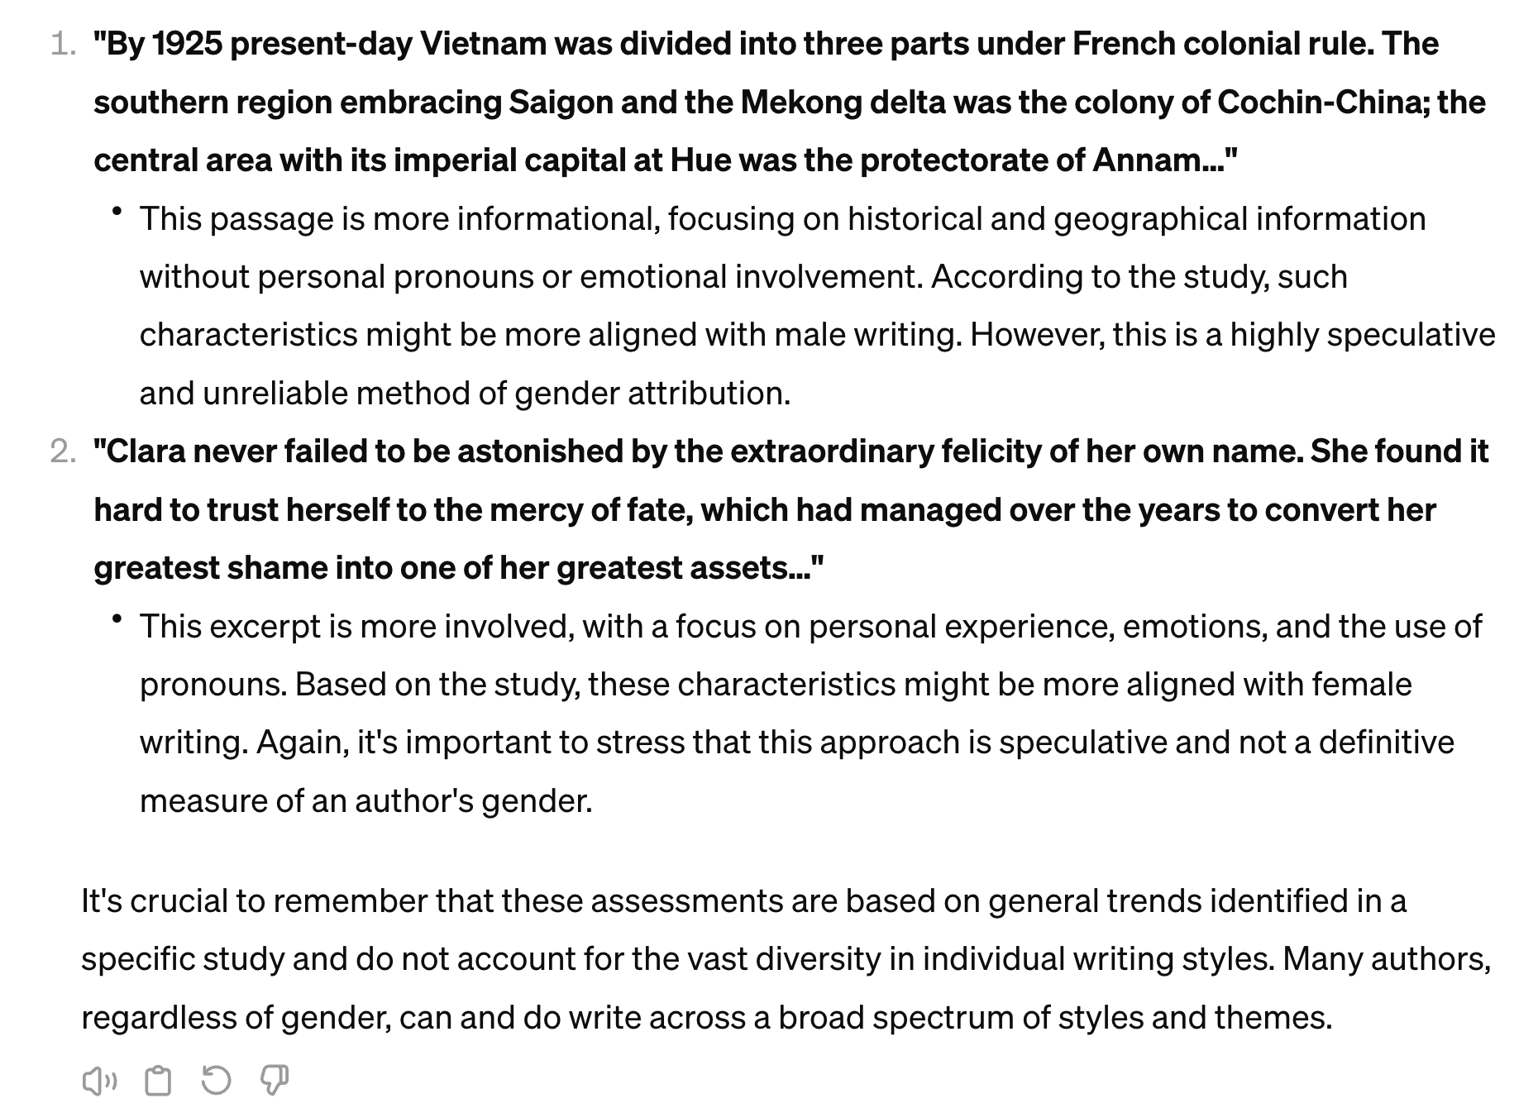
Male or female author?
By 1925 present-day Vietnam was divided into three parts under French colonial rule. The southern region embracing Saigon and the Mekong delta was the colony of Cochin-China; the central area with its imperial capital at Hue was the protectorate of Annam…
Clara never failed to be astonished by the extraordinary felicity of her own name. She found it hard to trust herself to the mercy of fate, which had managed over the years to convert her greatest shame into one of her greatest assets…
Argamon, Shlomo, Moshe Koppel, Jonathan Fine, and Anat Rachel Shimoni. "Gender, genre, and writing style in formal written texts." Text & talk 23, no. 3 (2003): 321-346.
Male / Female

Slide 7
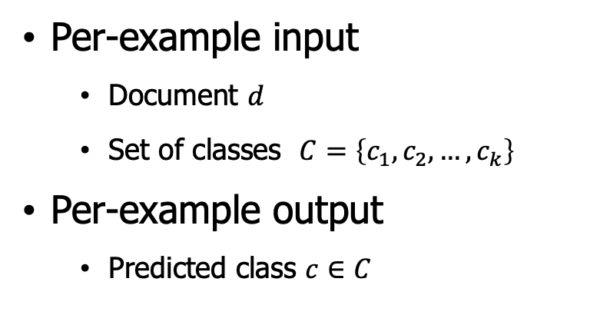
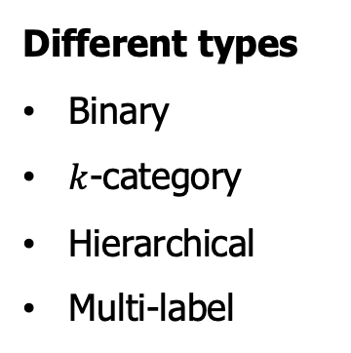
Text classification paradigm
Given
A set of predefined categories
A training set of labeled text (e.g., documents, passages)
Task
Classify a text object into one or more of the categories
Per-example input
Document $d$
Set of classes $C=\left\{c_{1},c_{2},…, c_{k}\right\}$
Per-example output
Predicted class $c∈C$
Different types
Binary
$k$-category
Hierarchical
Multi-label
Spam
Not spam
Classification Model
Spam
Not spam
…
Training data collecting
Model learning
Testing

Slide 8
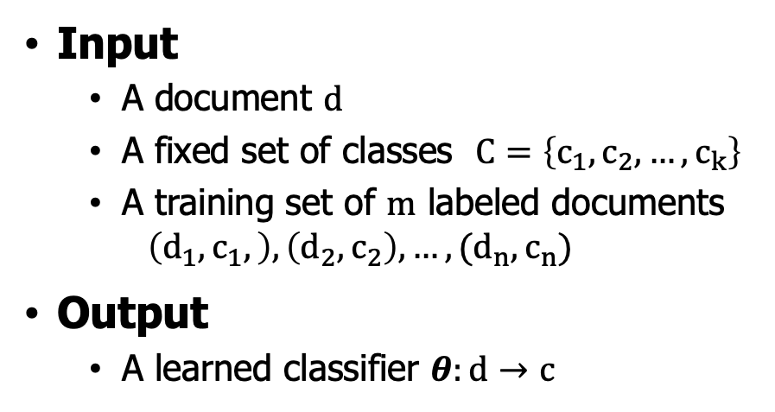
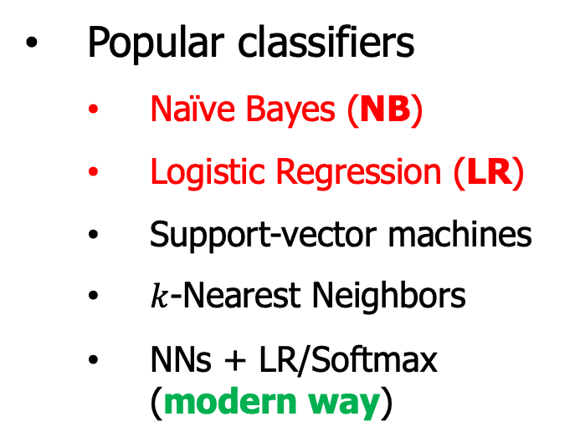
Classification methods
Hand-coded rules (outdated)
Rules based on combinations of words or other features (e.g., spam: black-list-address OR (“dollars” AND “have been selected”)
Accuracy can be high if rules carefully refined by expert. but building and maintaining these rules is expensive. Rules are changing from time to time
Supervised learning (still useful in certain sense)
Input
A document $d$
A fixed set of classes $C=\left\{c_{1},c_{2},…,c_{k}\right\}$
A training set of $m$ labeled documents
$$\left(d_{1},c_{1},\right),\left(d_{2},c_{2}\right),…,(d_{n},c_{n})$$
Output
A learned classifier $θ:d→c$
Popular classifiers
Naïve Bayes (NB)
Logistic Regression (LR)
Support-vector machines
$k$-Nearest Neighbors
NNs + LR/Softmax (modern way)

Slide 9
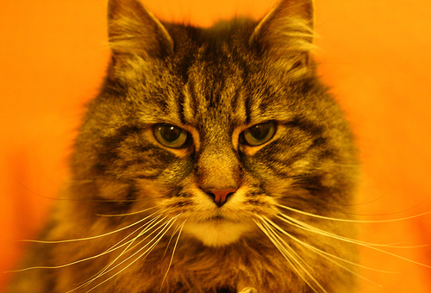

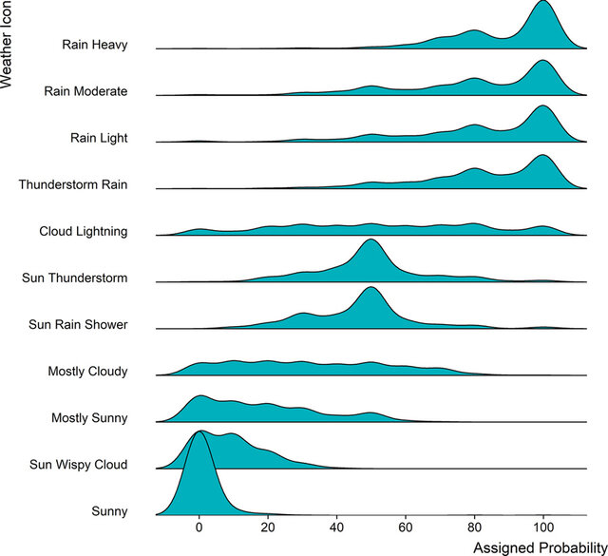
Generative and discriminative classifiers
Suppose we are distinguishing cat from dog images
Build a model of what is in a cat image: Knows about whiskers, ears, eyes; Assigns a probability to any image; and then ask how cat-y is this image? Also build a model for dog images
Now given a new image, run both models and see which one fits better
Just try to distinguish dogs from cats
Oh look, dogs have collars! Let's ignore everything else
Generative classifier (e.g., NB)
Discriminative classifier (e.g., LR)

Slide 10
Outline
Tasks of Text Classification
Naïve Bayes (NB) Classifier
Logistic Regression (LR) Classifier
Evaluation on text classification
Practice and others

Slide 11

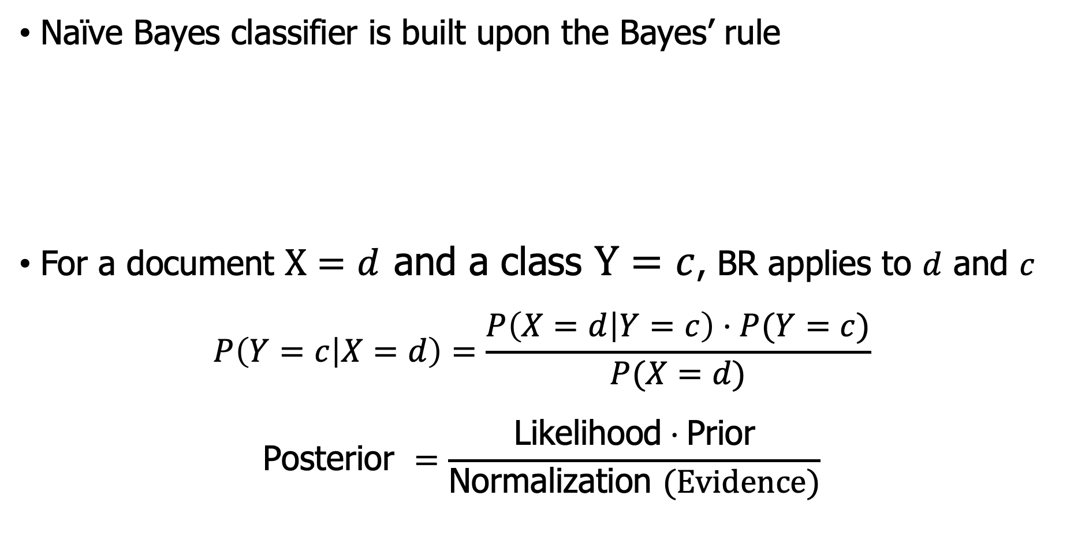
Motivation - Bayes’ Rule (BR)
Naïve Bayes classifier is built upon the Bayes’ rule
For a document $X=d$ and a class $Y=c$, BR applies to $d$ and $c$
$$P\left(Y=c | X=d\right)=\frac{P\left(X=d | Y=c\right)⋅P(Y=c)}{P(X=d)}$$
$$\text{Posterior} =\frac{\text{Likelihood}⋅\text{Prior}}{\text{Normalization} (Evidence)}$$

Slide 12
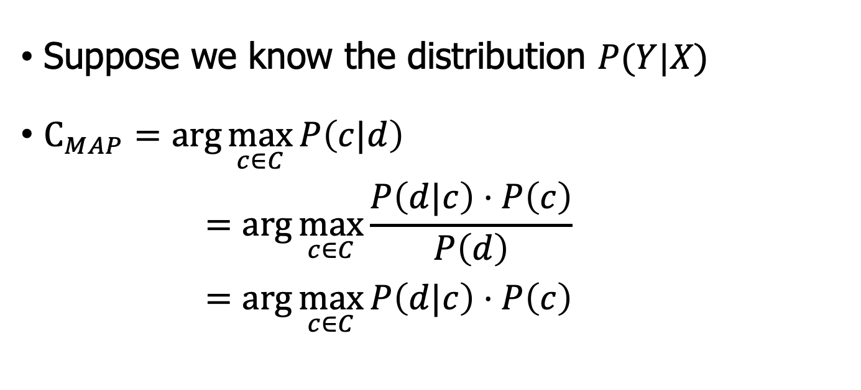

NB classifier – Bayes Rule
Suppose we know the distribution $P(Y|X)$
$C_{MAP}=\arg{\max_{c∈C}{P\left(c|d\right)}}$
$$=\arg{\max_{c∈C}{\frac{P\left(d|c\right)⋅P\left(c\right)}{P\left(d\right)}}}$$
$$=\arg{\max_{c∈C}{P\left(d|c\right)⋅P\left(c\right)}}$$
most likely class
Bayes Rule
Dropping the denominator
Document $d$ represented as features $v_{1},…,v_{|V|}$ by bay-of-words
$$c_{MAP}=\arg{\max_{c∈C}{P\left(d=v_{1},v_{2},…, v_{|V|}|c\right)⋅P\left(c\right)}}$$

Slide 13
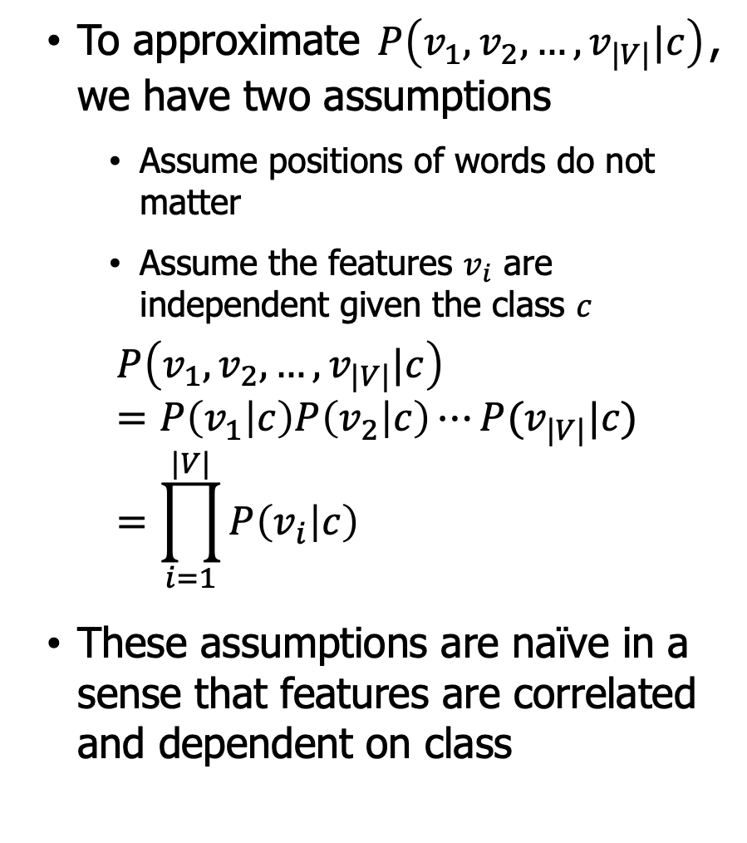
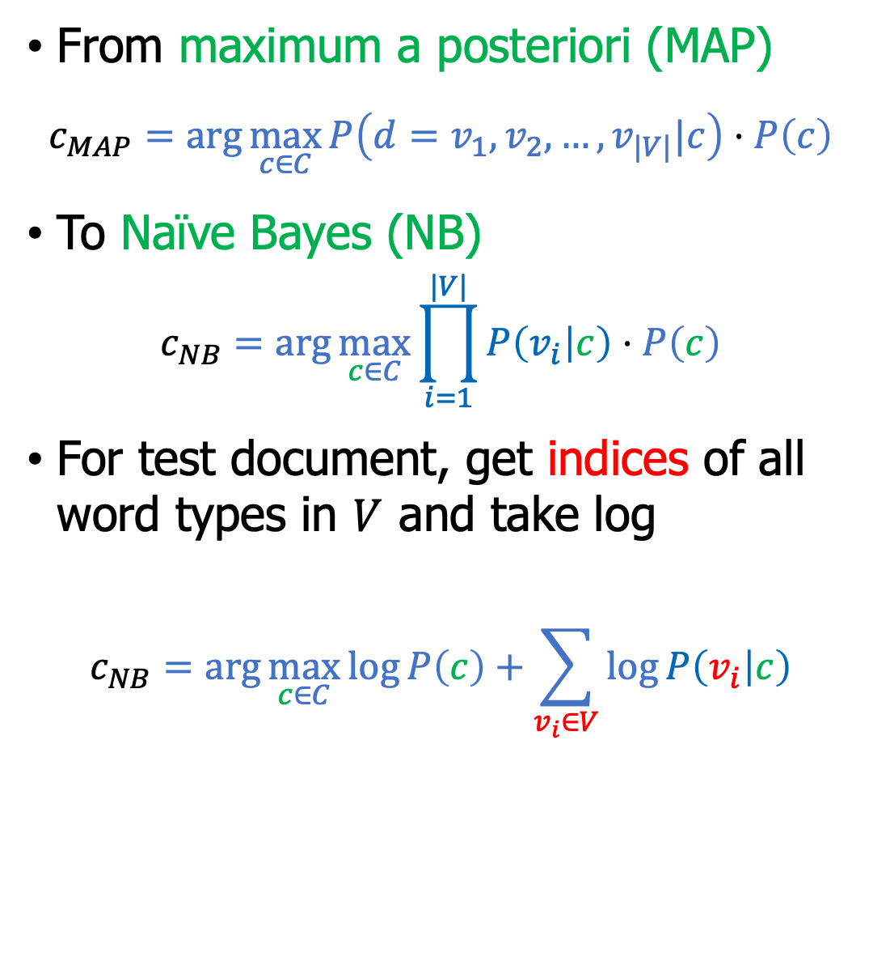
NB classifier – Assumptions and final NB
To approximate $P\left(v_{1},v_{2},…, v_{|V|}|c\right)$, we have two assumptions
Assume positions of words do not matter
Assume the features $v_{i}$ are independent given the class $c$
$$P\left(v_{1},v_{2},…, v_{|V|}|c\right)=P\left(v_{1} | c\right)P\left(v_{2} | c\right)⋯P(v_{|V|}|c)=\prod_{i=1}^{|V|}{P\left(v_{i} | c\right)}$$
These assumptions are naïve in a sense that features are correlated and dependent on class
From maximum a posteriori (MAP)
$$c_{MAP}=\arg{\max_{c∈C}{P\left(d=v_{1},v_{2},…, v_{|V|}|c\right)⋅P\left(c\right)}}$$
To Naïve Bayes (NB)
$$c_{NB}=\arg{\max_{c∈C}{\prod_{i=1}^{|V|}{P\left(v_{i} | c\right)}⋅P\left(c\right)}}$$
For test document, get indices of all word types in $V$ and take log
$$c_{NB}=\arg{\max_{c∈C}{\log{P\left(c\right)}+\sum_{v_{i}∈V}{\log{P\left(v_{i} | c\right)}}}}$$

Slide 14
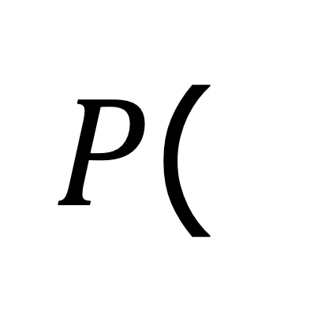
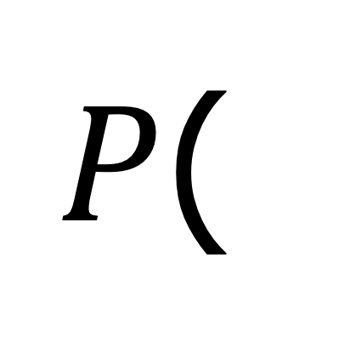
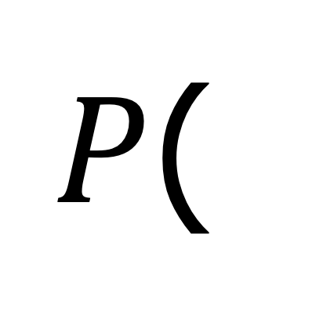
NB classifier - Bag-of-words
$P$(
| c)
I love this movie! It's sweet, but with satirical humor. The dialogue is great and the adventure scenes are fun… It manages to be whimsical and romantic while laughing at the conventions of the fairy tale genre. I would recommend it to just about anyone. I've seen it several times, and I'm always happy to see it again whenever I have a friend who hasn't seen it yet.
| c)
$P$(
I love this movie! It's sweet, but with satirical humor. The dialogue is great and the adventure scenes are fun… It manages to be whimsical and romantic while laughing at the conventions of the fairy tale genre. I would recommend it to just about anyone. I've seen it several times, and I'm always happy to see it again whenever I have a friend who hasn't seen it yet.
Using a subset of useful words
$P$(
great | 2
love | 2
recommend | 1
laugh | 1
happy | 1
... | ...
| c)

Slide 15
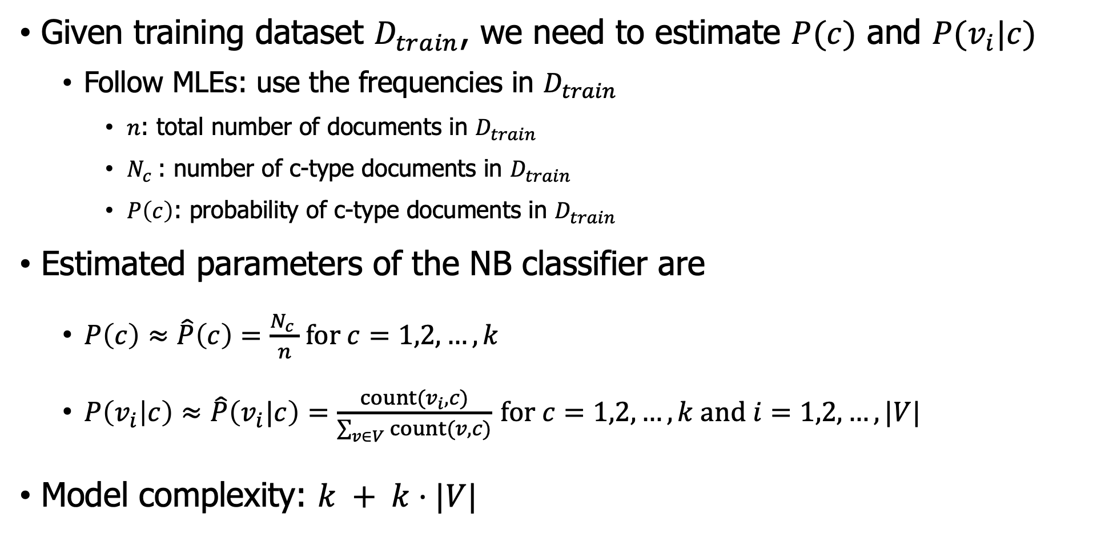
Model learning – estimating $P\left(c\right), P(v_{i}|c)$
Given training dataset $D_{train}$, we need to estimate $P(c)$ and $P(v_{i}|c)$
Follow MLEs: use the frequencies in $D_{train}$
$n$: total number of documents in $D_{train}$
$N_{c}$: number of c-type documents in $D_{train}$
$P\left(c\right)$: probability of c-type documents in $D_{train}$
Estimated parameters of the NB classifier are
$P\left(c\right)≈\hat{P}\left(c\right)=\frac{N_{c} }{n}$ for $c=1,2,…,k$
$P\left(v_{i} | c\right)≈\hat{P}\left(v_{i}|c\right)=\frac{count(v_{i},c)}{\sum_{v∈V}{count(v,c)}}$ for $c=1,2,…,k$ and $i=1,2,…,|V|$
Model complexity: $k + k⋅|V|$

Slide 16
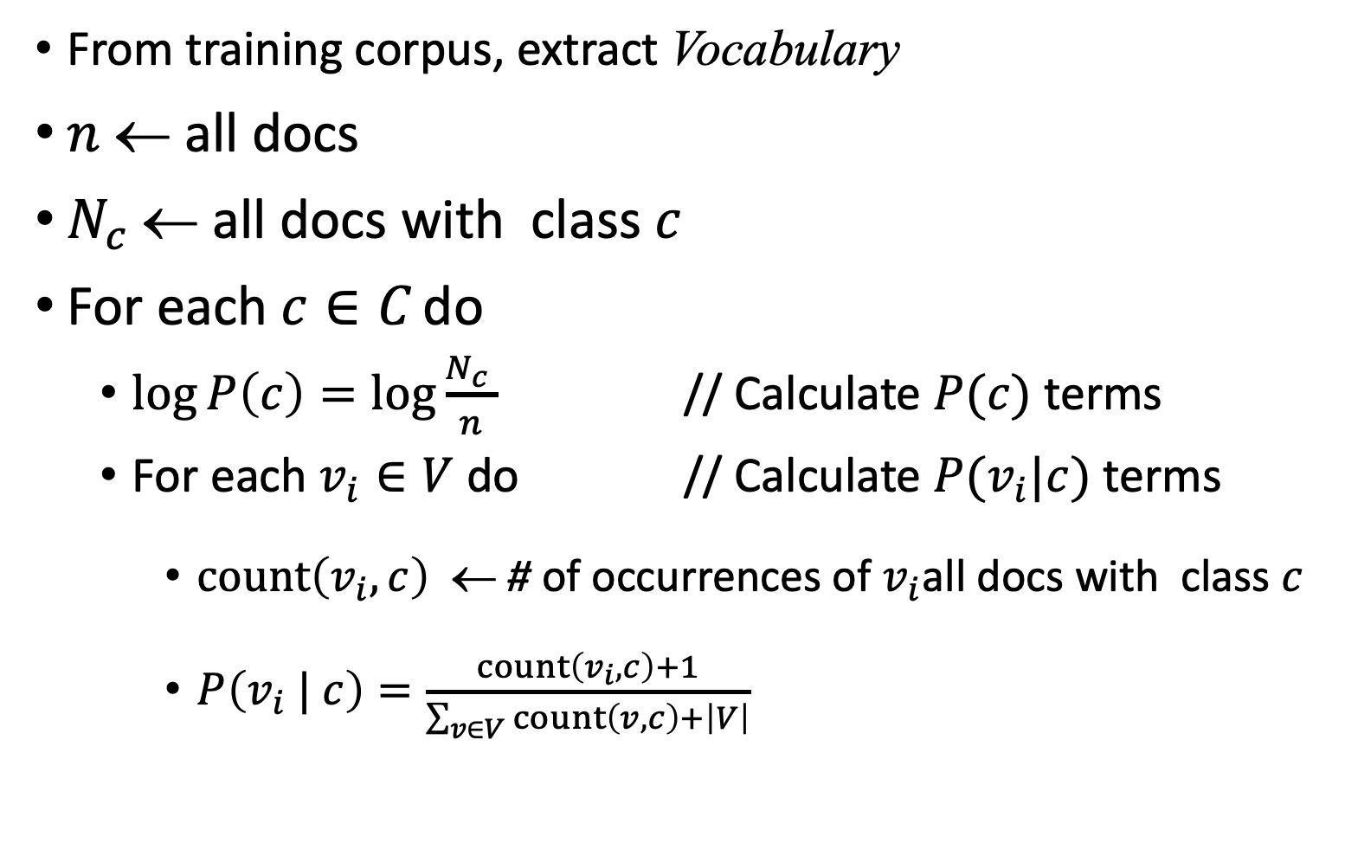
Model learning - Training Code
From training corpus, extract Vocabulary
$n$ ← all docs
$N_{c}$← all docs with class $c$
For each $c∈C$ do
$\log{P\left(c\right)}=\log{\frac{N_{c} }{n}}$ // Calculate $P(c)$ terms
For each $v_{i}∈V$ do // Calculate $P(v_{i}|c)$ terms
$count\left(v_{i},c\right)$ ← # of occurrences of $v_{i}$all docs with class $c$
$P\left(v_{i} | c\right)=\frac{count\left(v_{i},c\right)+1}{\sum_{v∈V}{count\left(v,c\right)}+\left|V\right|}$

Slide 17
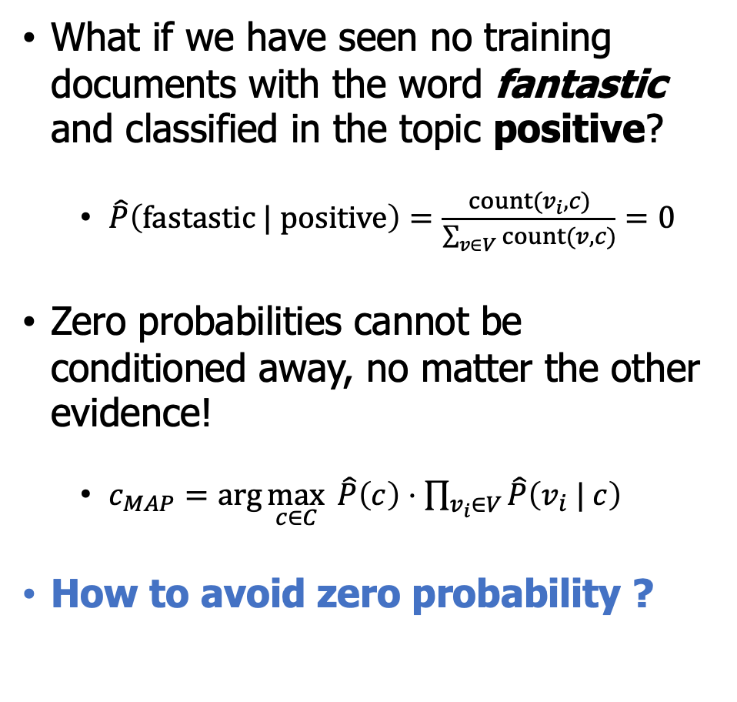
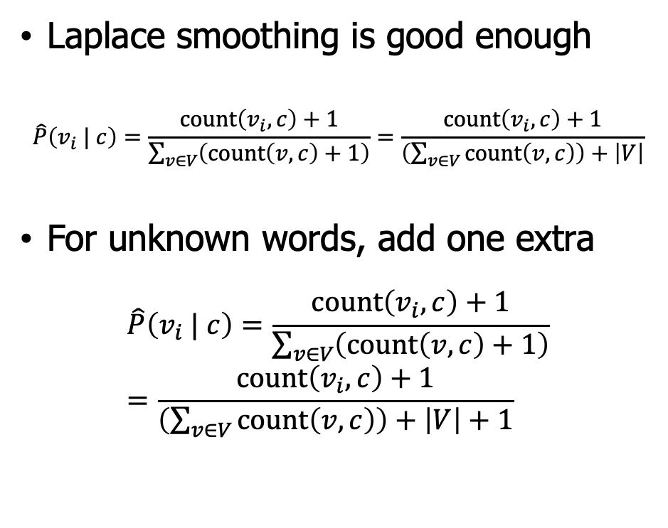
Model learning - Smoothing
What if we have seen no training documents with the word fantastic and classified in the topic positive?
$\hat{P}\left(fastastic | positive\right)=\frac{count(v_{i},c)}{\sum_{v∈V}{count(v,c)}}=0$
Zero probabilities cannot be conditioned away, no matter the other evidence!
$c_{MAP}=\arg{\max_{c∈C}{ \hat{P}\left(c\right)⋅\prod_{v_{i}∈V}{\hat{P}\left(v_{i} | c\right)} }}$
How to avoid zero probability ?
Laplace smoothing is good enough
$$\hat{P}\left(v_{i} | c\right)=\frac{count\left(v_{i},c\right)+1}{\sum_{v∈V}{\left(count\left(v,c\right)+1\right)}}=\frac{count\left(v_{i},c\right)+1}{\left(\sum_{v∈V}{count\left(v,c\right)}\right)+\left|V\right|}$$
For unknown words, add one extra
$$\hat{P}\left(v_{i} | c\right)=\frac{count\left(v_{i},c\right)+1}{\sum_{v∈V}{\left(count\left(v,c\right)+1\right)}}=\frac{count\left(v_{i},c\right)+1}{\left(\sum_{v∈V}{count\left(v,c\right)}\right)+\left|V\right|+1}$$

Slide 18
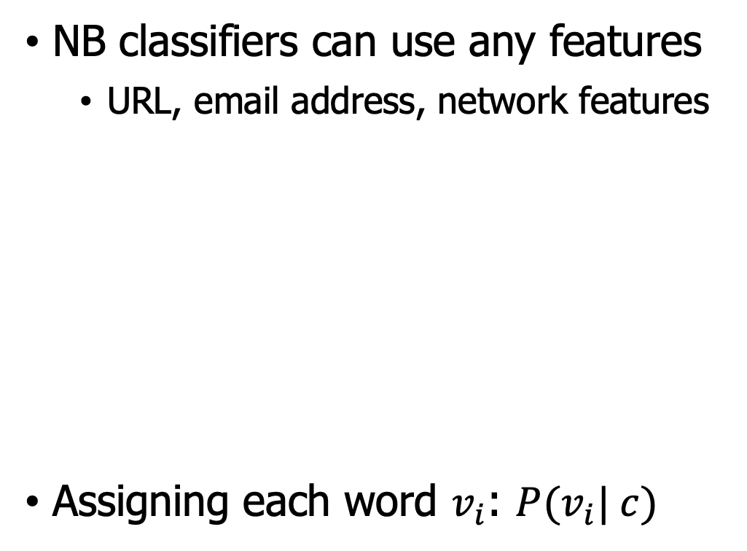
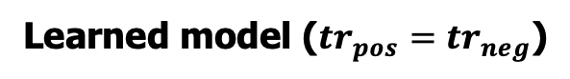
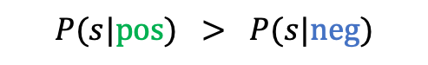
Model testing - Running example
Learned models are unigrams
Learned model ($tr_{pos}=tr_{neg}$)
NB classifiers can use any features
URL, email address, network features
Assigning each word $v_{i}$: $P(v_{i}| c)$
Model pos
Model neg
0.1 I
0.1 love
0.01 this
0.05 fun
0.1 film
0.2 I
0.001 love
0.01 this
0.005 fun
0.1 film
c=China
X₁=Shanghai
X₂=and
X₃=Shenzhen
X₄=issue
X₅=bonds
Which class assigns the higher probability to s?
s:
I
love
this
fun
film
0.1
0.1
0.01
0.05
0.1
0.2
0.001
0.01
0.005
0.1
$$P(s|pos) > P(s|neg)$$

Slide 19
Outline
Tasks of Text Classification
Naïve Bayes (NB) Classifier
Logistic Regression (LR) Classifier
Evaluation on text classification
Practice and others

Slide 20
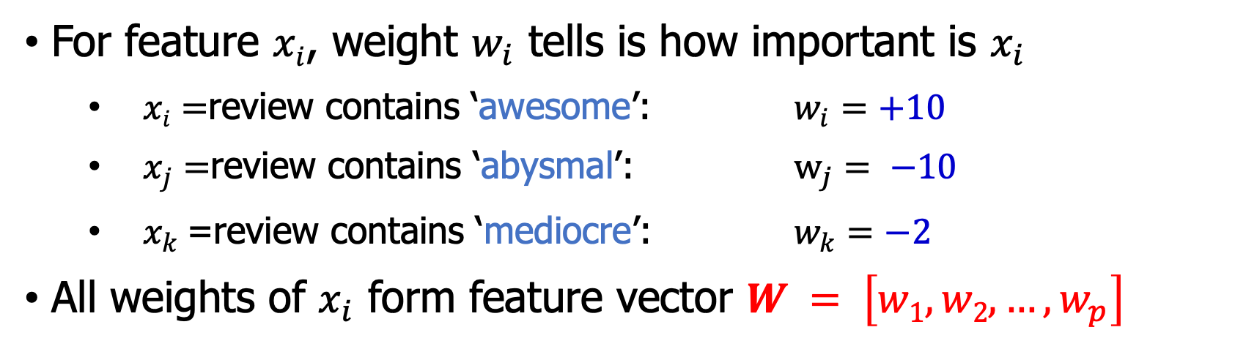
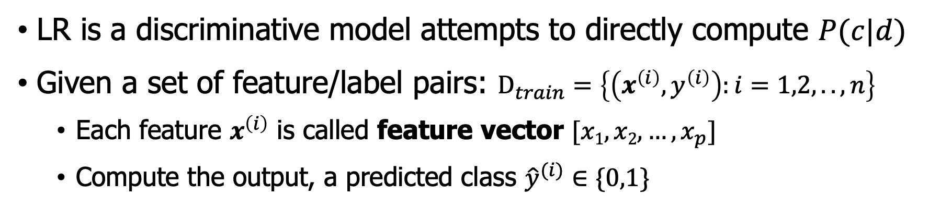
LR classifier – intuition
LR is a discriminative model attempts to directly compute $P(c|d)$
Given a set of feature/label pairs: $D_{train}=\left\{\left(x^{\left(i\right)},y^{\left(i\right)}\right):i=1,2,..,n\right\}$
Each feature $x^{\left(i\right)}$ is called feature vector $[x1, x2,…, x_{p}]$
Compute the output, a predicted class ${\hat{y}}^{(i)}∈\{0,1\}$
For feature $xi$, weight $w_{i}$ tells is how important is $x_{i}$
$xi=$review contains ‘awesome’: $w_{i}=+10$
$x_{j}=$review contains ‘abysmal’: $w_{j}= −10$
$x_{k}$=review contains ‘mediocre’: $w_{k}=−2$
All weights of $x_{i}$ form feature vector $W = \left[w1, w2,…, w_{p}\right]$

Slide 21
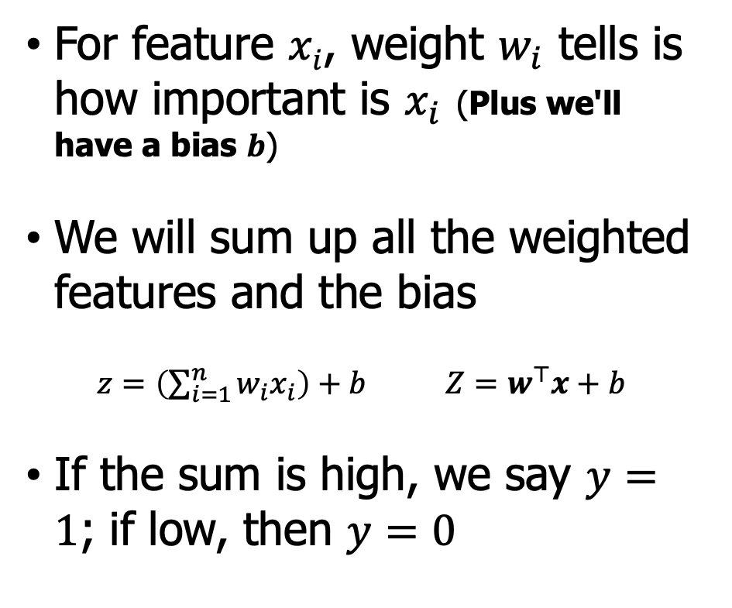
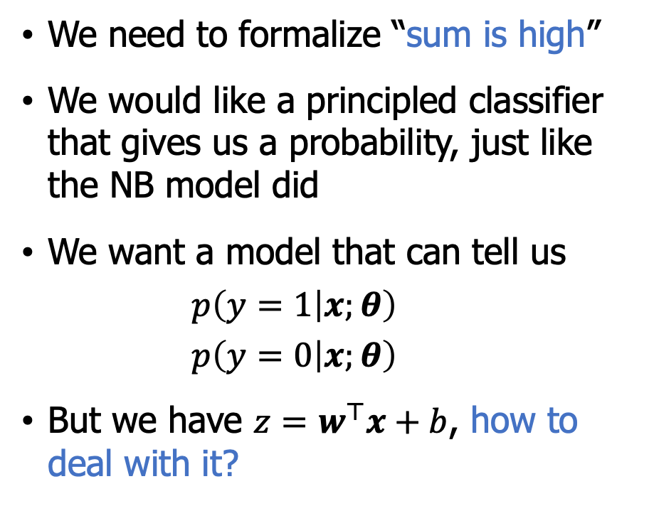
LR classifier – intuition
But we want a probabilistic classifier
For feature $xi$, weight $w_{i}$ tells is how important is $x_{i}$ (Plus we'll have a bias $b$)
We will sum up all the weighted features and the bias
$z=\left(\sum_{i=1}^{n}{w_{i}x_{i}}\right)+b$ $Z=w^{⊤}x+b$
If the sum is high, we say $y=1$; if low, then $y=0$
We need to formalize “sum is high”
We would like a principled classifier that gives us a probability, just like the NB model did
We want a model that can tell us
$$p\left(y=1 | x;θ\right)$$
$$p\left(y=0 | x;θ\right)$$
But we have $z=w^{⊤}x+b$, how to deal with it?

Slide 22
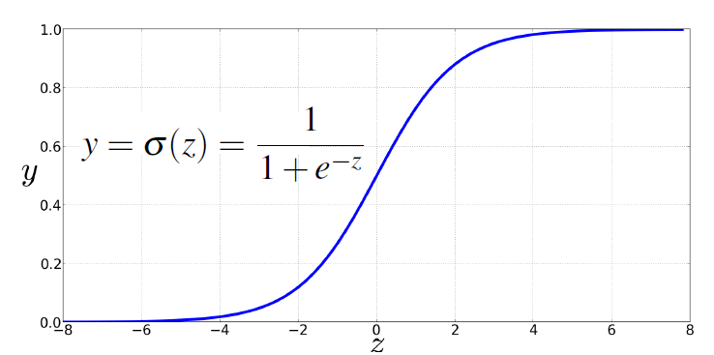
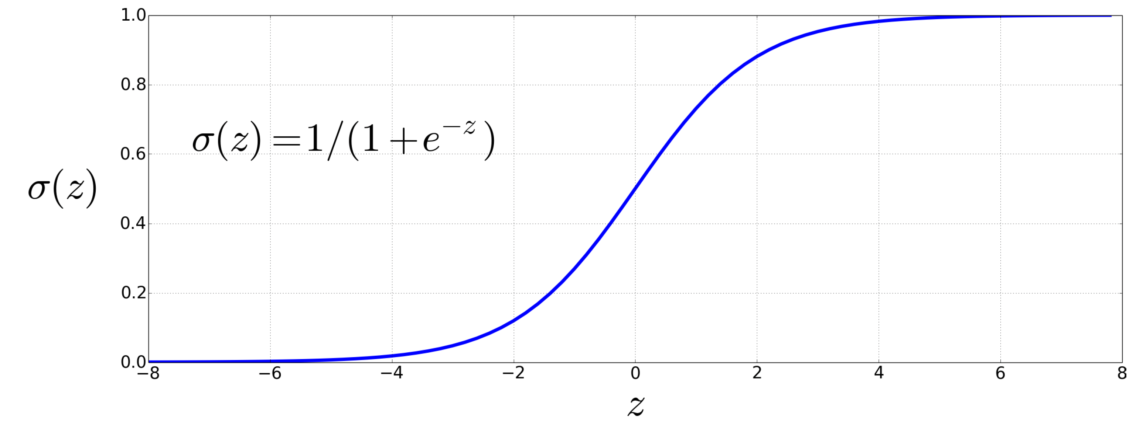
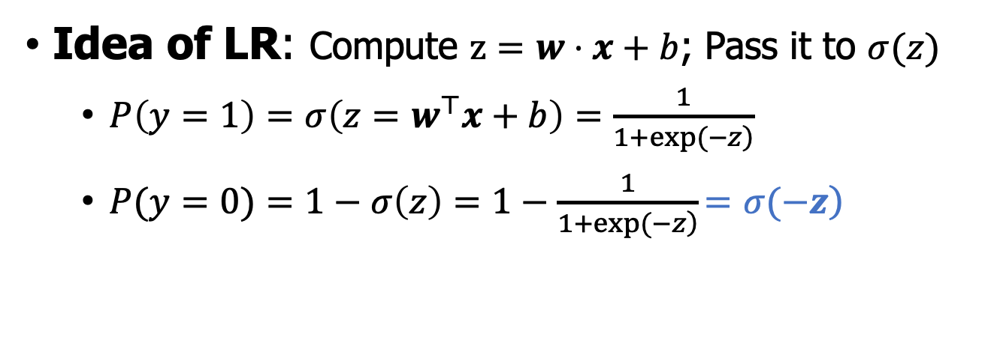
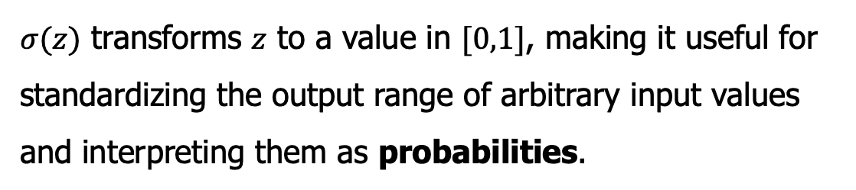
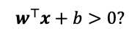
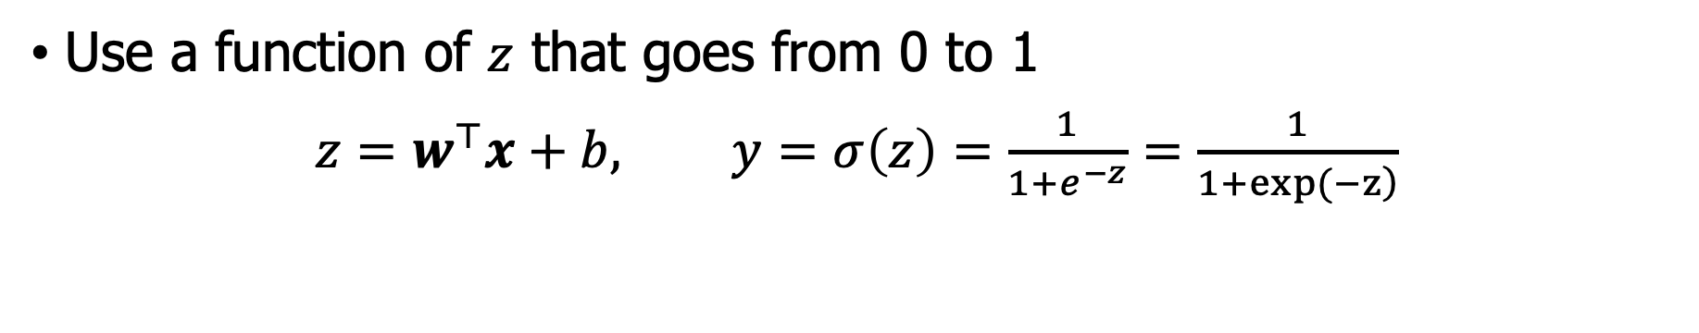
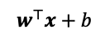
LR classifier – binary case
Use a function of $z$ that goes from 0 to 1
$z=w^{⊤}x+b,$ $y=σ\left(z\right)=\frac{1}{1+e^{−z}}=\frac{1}{\left.1+exp(−z\right)}$
$σ(z)$ transforms $z$ to a value in $[0,1]$, making it useful for standardizing the output range of arbitrary input values and interpreting them as probabilities.
Idea of LR: Compute $z=w⋅x+b$; Pass it to $σ(z)$
$P\left(y=1\right)=σ\left(z=w^{⊤}x+b\right)=\frac{1}{\left.1+exp(−z\right)}$
$P(y=0)=1−σ\left(z\right)=1−\frac{1}{\left.1+exp(−z\right)}\left.=σ(−z\right)$
$$w^{⊤}x+b$$
$$w^{⊤}x+b>0?$$

Slide 23
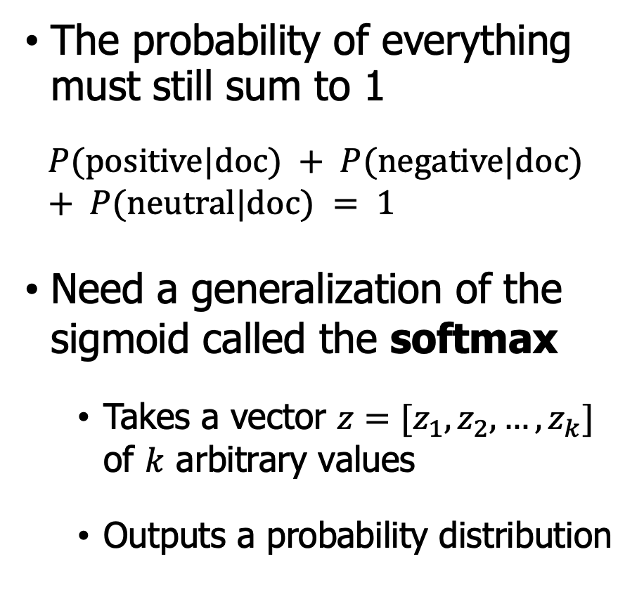
LR classifier – multinomial case
Often need 2 classes
Positive/negative/neutral
POS (noun, verb, adjective, adverb, preposition)
Softmax regression
= Multinomial LR
= Multinomial logit
= Maximum entropy modeling
The probability of everything must still sum to 1
$$P(positive|doc) + P(negative|doc) + P(neutral|doc) = 1$$
Need a generalization of the sigmoid called the softmax
Takes a vector $z=[z_{1},z_{2},…,z_{k}]$ of $k$ arbitrary values
Outputs a probability distribution

Slide 24
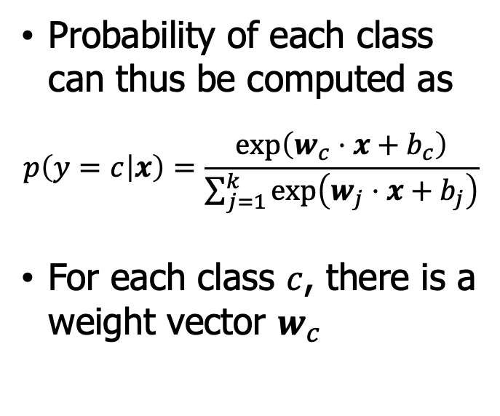
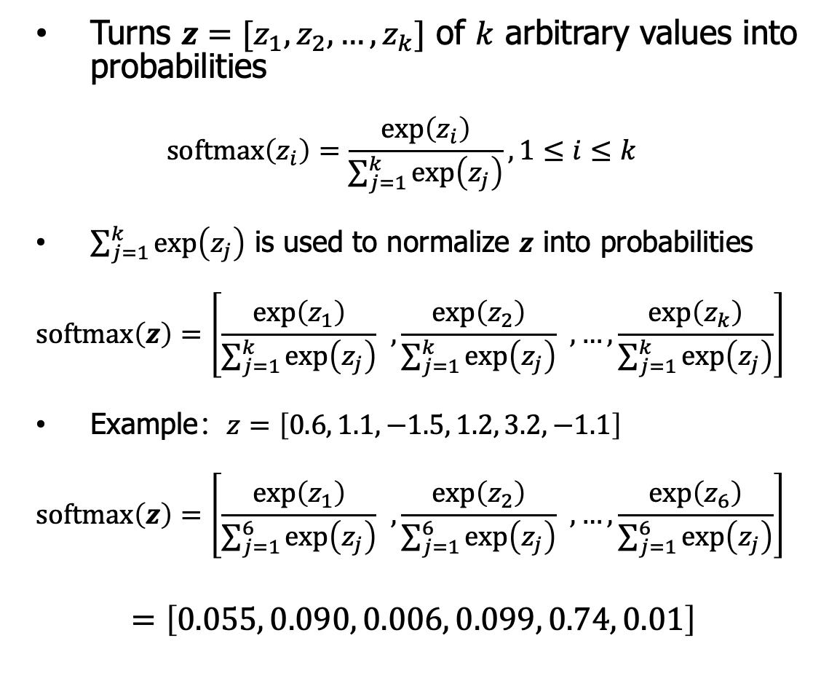
LR classifier – softmax
Turns $z=[z_{1},z_{2},…,z_{k}]$ of $k$ arbitrary values into probabilities
$$softmax\left(z_{i}\right)=\frac{\exp\left(z_{i}\right)}{\sum_{j=1}^{k}{\exp\left(z_{j}\right)}}, 1≤i≤k$$
$\sum_{j=1}^{k}{\exp\left(z_{j}\right)}$ is used to normalize $z$ into probabilities
$$softmax\left(z\right)=\left[\frac{\exp\left(z_{1}\right)}{\sum_{j=1}^{k}{\exp\left(z_{j}\right)}} ,\frac{\exp\left(z_{2}\right)}{\sum_{j=1}^{k}{\exp\left(z_{j}\right)}} ,…, \frac{\exp\left(z_{k}\right)}{\sum_{j=1}^{k}{\exp\left(z_{j}\right)}}\right]$$
Example：$z=\left[0.6, 1.1, −1.5, 1.2, 3.2,−1.1\right]$
$$softmax\left(z\right)=\left[\frac{\exp\left(z_{1}\right)}{\sum_{j=1}^{6}{\exp\left(z_{j}\right)}} ,\frac{\exp\left(z_{2}\right)}{\sum_{j=1}^{6}{\exp\left(z_{j}\right)}} ,…, \frac{\exp\left(z_{6}\right)}{\sum_{j=1}^{6}{\exp\left(z_{j}\right)}}\right]$$
$$=\left[0.055, 0.090, 0.006, 0.099, 0.74, 0.01\right]$$
Softmax in multinomial LR
Probability of each class can thus be computed as
$$p\left(y=c | x\right)=\frac{\exp\left(w_{c}⋅x+b_{c}\right)}{\sum_{j=1}^{k}{\exp\left(w_{j}⋅x+b_{j}\right)}}$$
For each class $c$, there is a weight vector $w_{c}$

Slide 25
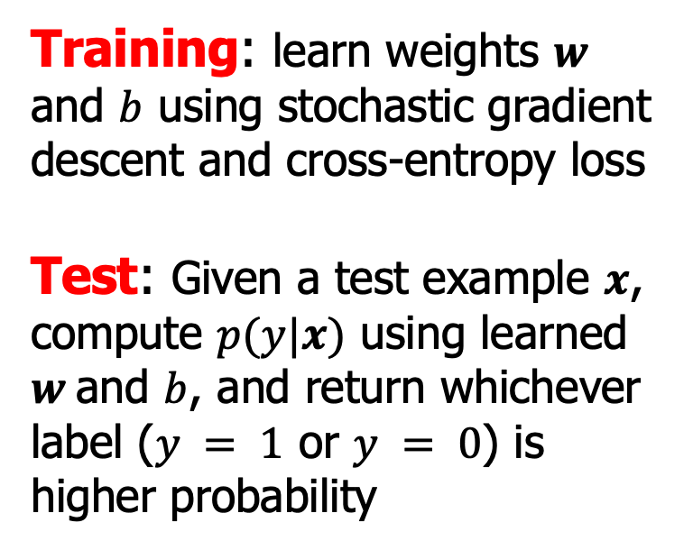
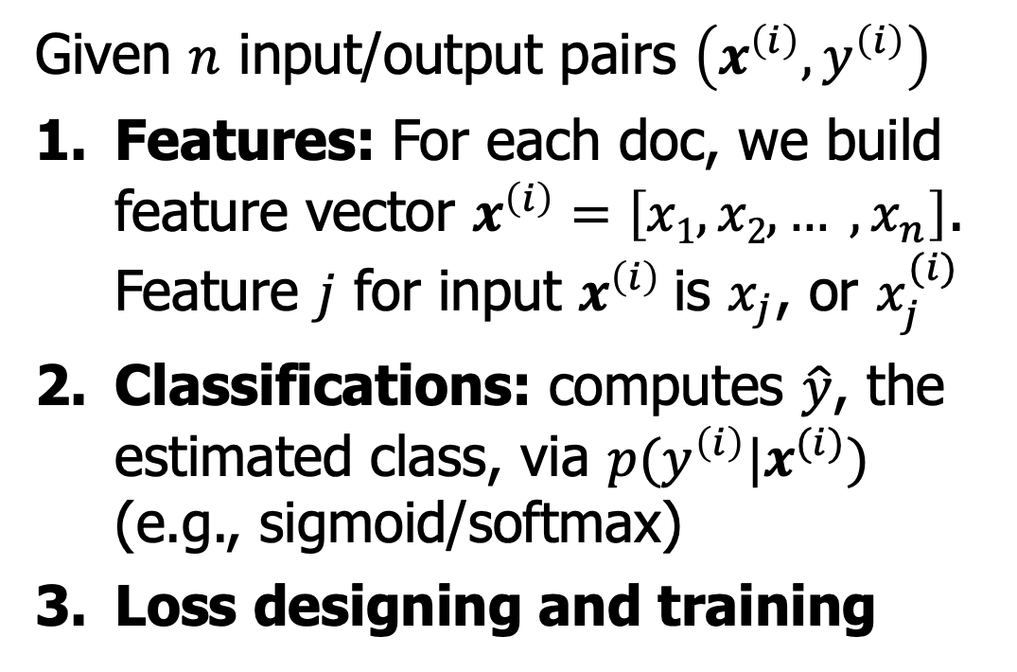
Model learning – general paradigm
Given $n$ input/output pairs $\left(x^{\left(i\right)},y^{\left(i\right)}\right)$
Features: For each doc, we build feature vector $x^{\left(i\right)}=\left[x1, x2, … , x_{n}\right]$. Feature $j$ for input $x^{\left(i\right)}$is $x_{j}$, or $x_{j}^{(i)}$
Classifications: computes $\hat{y}$, the estimated class, via $p(y^{\left(i\right)}|x^{(i)})$ (e.g., sigmoid/softmax)
Loss designing and training
The two phases of LR
Training: learn weights $w$ and $b$ using stochastic gradient descent and cross-entropy loss
Test: Given a test example $x$, compute $p(y|x)$ using learned $w$and $b$, and return whichever label ($y = 1$ or $y = 0$) is higher probability

Slide 26
Model learning – building features $x^{\left(i\right)}$
Given the following movie review text
It's hokey . There are virtually no surprises , and the writing is second-rate .So why was it so enjoyable ? For one thing , the cast is great . Another nice touch is the music . I was overcome with the urge to get off the couch and start dancing . It sucked me in , and it'll do the same to you .
How many words in this review?

Slide 27
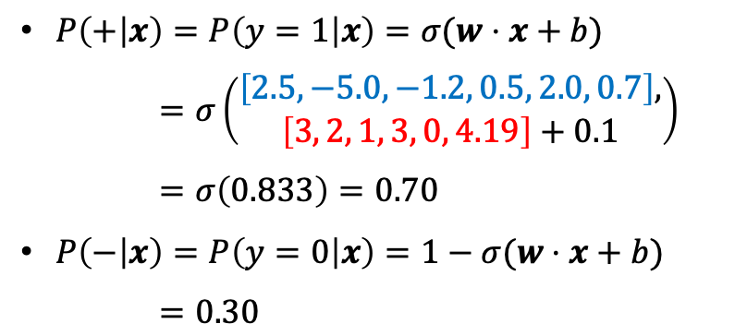
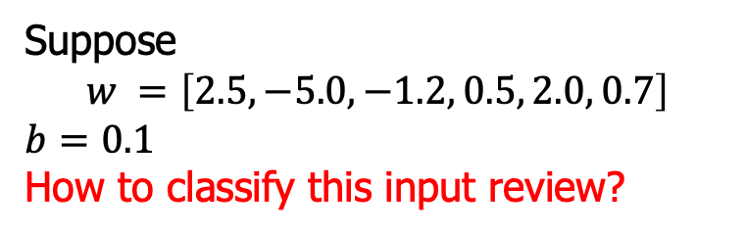
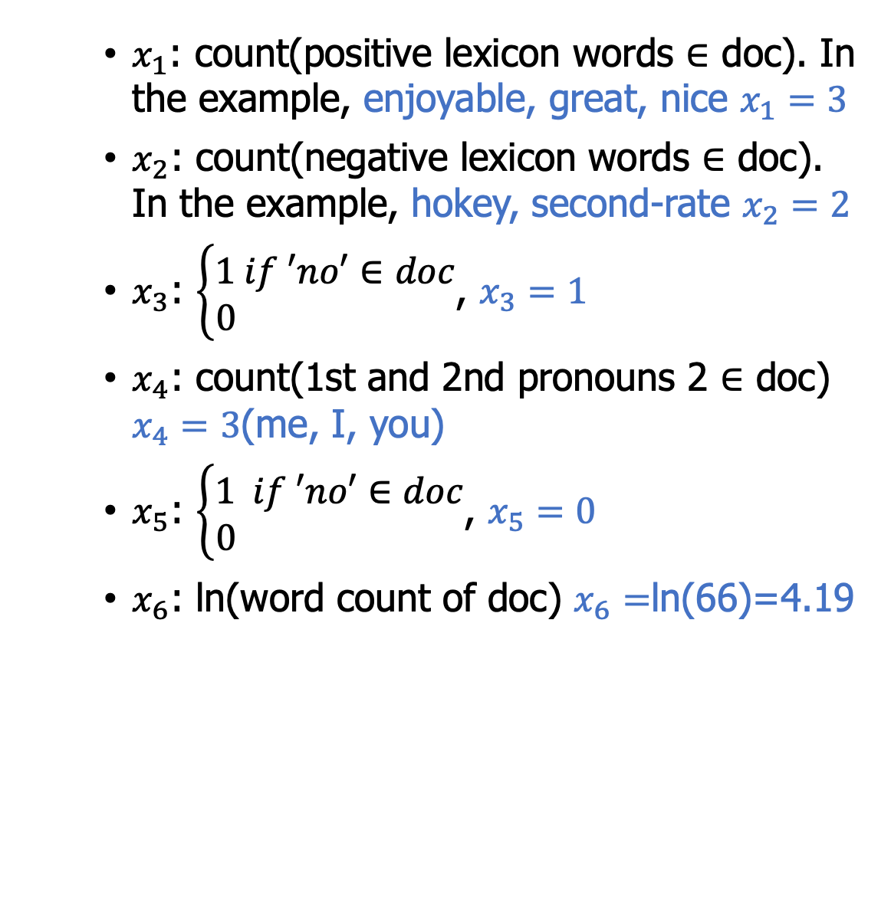
Model learning – building features $x^{\left(i\right)}$
$x_{1}$: count(positive lexicon words $∈$ doc). In the example, enjoyable, great, nice $x_{1}=3$
$x_{2}$: count(negative lexicon words $∈$ doc). In the example, hokey, second-rate $x_{2}=2$
$x_{3}$: $\left\{\begin{aligned}1 if ′no′∈doc \\ 0 \end{aligned}\right.$, $x_{3}=1$
$x_{4}$: count(1st and 2nd pronouns 2 $∈$ doc) $x_{4}=3$(me, I, you)
$x_{5}$: $\left\{\begin{aligned}1 if ′no′∈doc \\ 0 \end{aligned}\right.$, $x_{5}=0$
$x_{6}$: ln(word count of doc) $x_{6}=$ln(66)=4.19
Suppose
$$w =\left[2.5,−5.0,−1.2, 0.5, 2.0, 0.7\right]$$
$$b=0.1$$
How to classify this input review?
$P\left(+ | x\right)=P\left(y=1 | x\right)=σ(w⋅x+b)$
$=σ\left(\begin{aligned}\left[2.5,−5.0,−1.2, 0.5, 2.0, 0.7\right], \\ \left[3, 2, 1, 3, 0, 4.19\right]+0.1\end{aligned}\right)$
$=σ\left(0.833\right)=0.70$
$P\left(− | x\right)=P\left(y=0 | x\right)=1−σ(w⋅x+b)$
$=0.30$

Slide 28
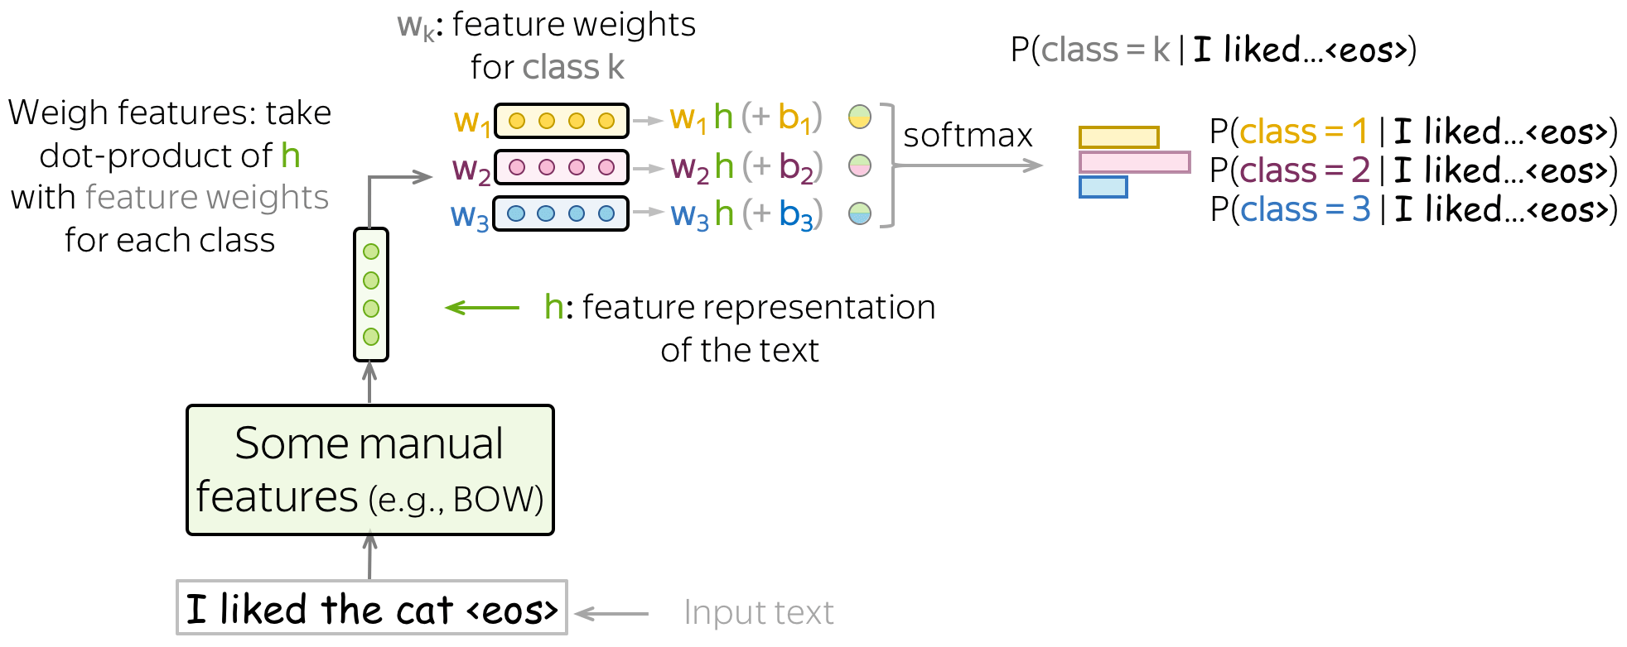
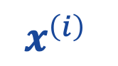
Model learning – building features $x^{\left(i\right)}$
$x^{\left(i\right)}$
https://lena-voita.github.io/nlp_course/text_classification.html

Slide 29
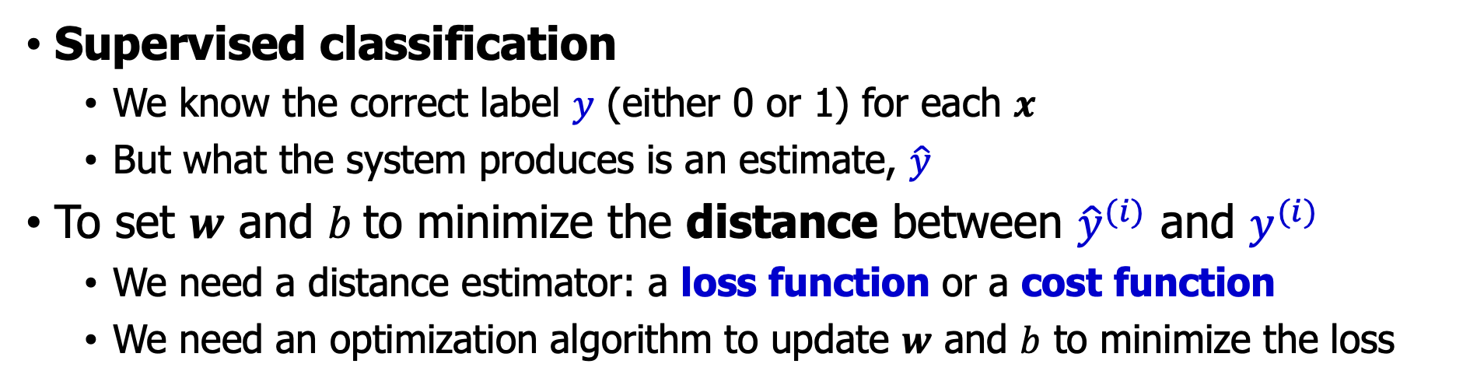
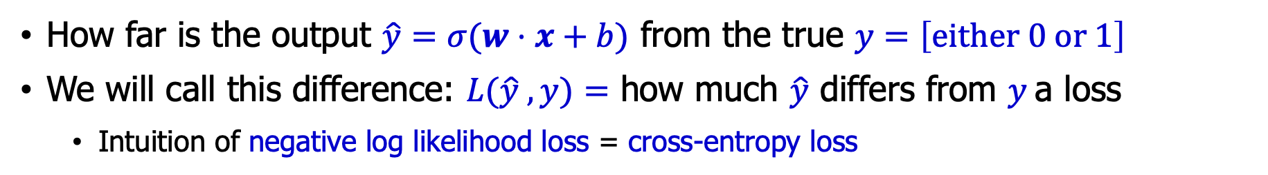
Model learning – loss design
Supervised classification
We know the correct label $y$ (either 0 or 1) for each $x$
But what the system produces is an estimate, $\hat{y}$
To set $w$ and $b$to minimize the distance between ${\hat{y}}^{(i)}$ and $y^{(i)}$
We need a distance estimator: a loss function or a cost function
We need an optimization algorithm to update $w$ and $b$ to minimize the loss
How far is the output $\hat{y}=σ(w⋅x+b)$ from the true $y=\left[either 0 or 1\right]$
We will call this difference: $L(\hat{y} ,y)=$ how much $\hat{y}$ differs from $y$a loss
Intuition of negative log likelihood loss = cross-entropy loss

Slide 30
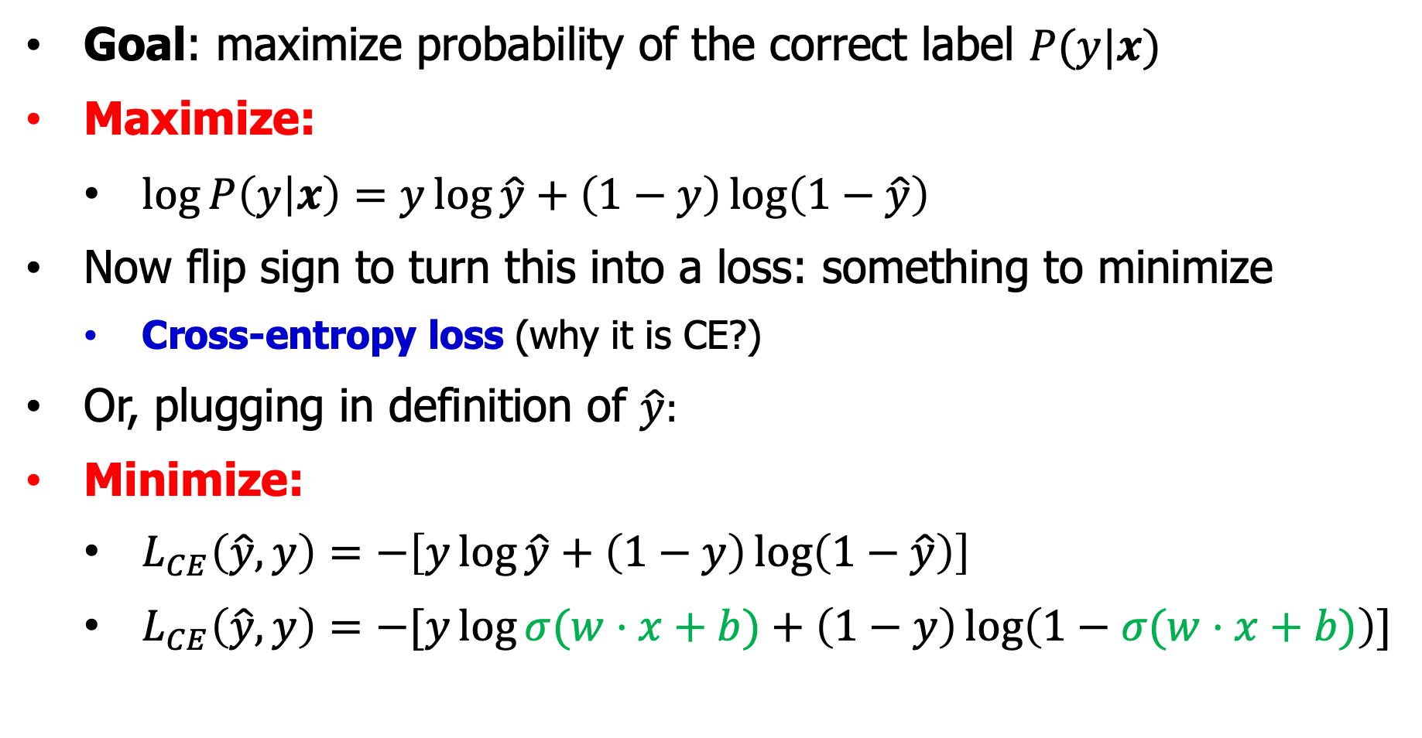
Model learning – cross-entropy loss
Goal: maximize probability of the correct label $P(y|x)$
Maximize:
$\log{P\left(y | x\right)}=y\log{\hat{y}}+\left(1−y\right)\log\left(1−\hat{y}\right)$
Now flip sign to turn this into a loss: something to minimize
Cross-entropy loss (why it is CE?)
Or, plugging in definition of $\hat{y}:$
Minimize:
$L_{CE}\left(\hat{y},y\right)=−\left[y\log{\hat{y}}+\left(1−y\right)\log\left(1−\hat{y}\right)\right]$
$L_{CE}\left(\hat{y},y\right)=−[y\log{σ(w⋅x+b)}+\left(1−y\right)\log\left(1−σ(w⋅x+b)\right)]$

Slide 31


Model learning – cross-entropy loss
We choose the parameters $w,b$ that maximize: the log probability of the true $y$labels in the training data given the observations $x$
Goal: maximize probability of the correct label $p(y|x)$
Since there are only 2 discrete outcomes (0 or 1) we can express the probability $p(y|x)$ from our classifier (the thing we want to maximize) as
$$p\left(y | x\right)={\hat{y}}^{y}{\left(1−\hat{y}\right)}^{1−y}$$
If $y=1$, this simplifies to $\hat{y}$
If $y=0$, this simplifies to $1−\hat{y}$
Take the log of both sides
$$\log{p\left(y | x\right)}=y\log{\hat{y}}+\left(1−y\right)\log\left(1−\hat{y}\right)$$

Slide 32

Model learning – example loss
We want loss to be
smaller if the model estimate is close to correct
bigger if model is confused
Let's first suppose the true label of this is $y=1$ (positive)
It's hokey . There are virtually no surprises , and the writing is second-rate . So why was it so enjoyable ? For one thing , the cast is great . Another nice touch is the music . I was overcome with the urge to get off the couch and start dancing . It sucked me in , and it'll do the same to you .

Slide 33


Model learning – example loss
True value is y=1. How well is our model doing?
$P\left(+ | x\right)=P\left(y=1 | x\right)=σ(w⋅x+b)$
$=σ\left(\left[2.5,−5.0,−1.2, 0.5, 2.0, 0.7\right],\left[3, 2, 1, 3, 0, 4.19\right]+0.1\right)$
$=σ\left(0.833\right)=0.70$
Pretty well! What’s the loss?
$$L_{CE}\left(\hat{y},y\right)=−[y\log{σ(w⋅x+b)}+\left(1−y\right)\log\left(1−σ(w⋅x+b)\right)]$$
$=−\log{σ\left(w⋅x+b\right)}$
$=−\log\left(0.70\right)$
$=0.36$

Slide 34


Model learning – example loss
Suppose true value instead was $y=0$.
$P\left(− | x\right)=P\left(y=0 | x\right)=1−σ(w⋅x+b)$
$=1−σ\left(\left[2.5,−5.0,−1.2, 0.5, 2.0, 0.7\right],\left[3, 2, 1, 3, 0, 4.19\right]+0.1\right)$
$=1−σ\left(0.833\right)=0.30$
What's the loss?
$$L_{CE}\left(\hat{y},y\right)=−[y\log{σ(w⋅x+b)}+\left(1−y\right)\log\left(1−σ(w⋅x+b)\right)]$$
$=−\log{(1−σ\left(w⋅x+b\right))}$
$=−\log\left(0.30\right)$
$=1.2$

Slide 35



Model learning – example loss checking
When model was right (if true $y=1$)
When model was wrong (if true $y=0$)
Loss was bigger when model was wrong!
$$L_{CE}\left(\hat{y},y\right)=−[y\log{σ(w⋅x+b)}+\left(1−y\right)\log\left(1−σ(w⋅x+b)\right)]$$
$=−\log{σ\left(w⋅x+b\right)}$
$=−\log\left(0.70\right)$
$=0.36$
$$L_{CE}\left(\hat{y},y\right)=−[y\log{σ(w⋅x+b)}+\left(1−y\right)\log\left(1−σ(w⋅x+b)\right)]$$
$=−\log{(1−σ\left(w⋅x+b\right))}$
$=−\log\left(0.30\right)$
$=1.2$

Slide 36


Model learning – estimating $w,b$
Recall the loss is parameterized by weights $Θ=\left(w,b\right)$
Represent $\hat{y}$as $f(x;θ)$ to make parameter $θ$ more obvious
We want $θ$ to minimize the loss, averaged over all examples
$$\hat{θ}=\arg{\min_{θ}{ℓ\left(θ\right)≡\frac{1}{m}\sum_{i=1}^{m}{L_{CE}\left(f\left(x^{\left(i\right)};θ\right),y^{(i)}\right)}}}$$
Loss function $ℓ(θ)$ is convex
A convex function has just one minimum
Gradient descent starting from any point is guaranteed to find the minimum

Slide 37


Model learning – gradient descent (GD)
How do I get to the bottom of this river canyon?
Look around me 360∘
Find the direction of steepest slope down
Go that way
$$x$$

Slide 38
Model learning – GD
Q: Given current $w$, should we make it bigger or smaller?
A: Move $w$ in the reverse direction from the slope of the function

Slide 39
Model learning – GD
Q: Given current w, should we make it bigger or smaller?
A: Move w in the reverse direction from the slope of the function
So we'll move positive

Slide 40
Model learning – GD
Q: Given current w, should we make it bigger or smaller?
A: Move w in the reverse direction from the slope of the function
So we'll move positive

Slide 41

Model learning – GD
The gradient of a function of many variables is a vector pointing in the direction of the greatest increase in a function.
Gradient Descent: Find the gradient of the loss function at the current point and move in the opposite direction.
How much do we move in that direction ?
The value of the gradient (slope) $\frac{d}{dθ}ℓ(f\left(x;θ\right),y)$ weighted by a learning rate $η$ (Higher $η$ means move $w$ faster)
$$θ^{t+1}=θ^{t}−η\frac{d}{dθ}ℓ\left(f\left(x;θ\right),y\right)$$

Slide 42


Model learning – $N$ dimensions
We want to know where in the $N$-dimensional space (of the $N$ parameters that make up $θ$ ) we should move.
The gradient is just such a vector; it expresses the directional components of the sharpest slope along each of the $N$ dimensions.
Visualizing the gradient vector at the red point
It has two dimensions shown in the x-y plane

Slide 43

Model learning – Gradients
Are much longer; lots and lots of weights
For each dimension $w_{i}$ the gradient component $i$ tells us the slope with respect to that variable.
“How much would a small change in $w_{i}$ influence the total loss function $L$?”
We express the slope as a partial derivative $∂$ of the loss $∂w_{i}$
The gradient is then defined as a vector of these partials.

Slide 44

Model learning – Gradients
We’ll represent $\hat{y}$as $f(x;θ)$ to make the dependence on $θ$ more obvious:
$$∇_{θ}L\left(f\left(x;θ\right),y\right)=\left[\begin{aligned}\begin{matrix}\frac{∂}{∂w_{1}}L\left(f\left(x;θ\right),y\right) \\ \frac{∂}{∂w_{2}}L\left(f\left(x;θ\right),y\right) \\ ⋮\end{matrix} \\ \frac{∂}{∂w_{n}}L\left(f\left(x;θ\right),y\right) \\ \frac{∂}{∂b}L\left(f\left(x;θ\right),y\right)\end{aligned}\right]$$
The final equation for updating $θ$ based on the gradient is thus
$θ^{t+1}=θ^{t}−η∇_{θ}L\left(f\left(x;θ\right),y\right)$

Slide 45

Model learning – Partial derivatives for LR
The loss function
The elegant derivative of this function
$$\frac{∂L_{CE}\left(\hat{y},y\right)}{∂w_{j}}=\left[σ\left(w⋅x+b\right)−y\right]⋅x_{j}$$
How can we get above derivative?
$$L_{CE}\left(\hat{y},y\right)=−[y\log{σ(w⋅x+b)}+\left(1−y\right)\log\left(1−σ(w⋅x+b)\right)]$$

Slide 46

Model learning – SGD
One step of gradient descent
A mini-sentiment example, where the true $y=1$(positive)
Two features
$x1 = 3$ (count of positive lexicon words)
$x2 = 2$ (count of negative lexicon words)
Assume 3 parameters (2 weights and 1 bias)
At initial $θ^{0}$ are zero, learning rate $η=0.1$
$w1 = w2 = b = 0$
$η = 0.1$

Slide 47








Model learning – Example of GD
$$w1=w2=b=0$$
$$x1=3; x2 =2$$
Update step for update $θ$ is:
where recall that
Gradient vector has 3 dimensions:
$θ^{t+1}=θ^{t}−η∇_{θ}L\left(f\left(x;θ\right),y\right)$
$$\frac{∂L\left(\hat{y},y\right)}{∂w_{j}}=\left[σ\left(w⋅x+b\right)−y\right]⋅x_{j}$$
$$∇_{θ}=∇_{w,b}=\left[\begin{matrix}\frac{∂L\left(\hat{y},y\right)}{∂w_{1}} \\ \frac{∂L\left(\hat{y},y\right)}{∂w_{2}} \\ \frac{∂L\left(\hat{y},y\right)}{∂b}\end{matrix}\right]$$
$$=\left[\begin{aligned}(σ\left(w⋅x+b\right)−y)⋅x_{1} \\ (σ\left(w⋅x+b\right)−y)⋅x_{2} \\ (σ\left(w⋅x+b\right)−y)⋅1\end{aligned}\right]$$
$$=\left[\begin{aligned}(σ\left(0\right)−1)⋅x_{1} \\ (σ\left(0\right)−1)⋅x_{2} \\ (σ\left(0\right)−1)⋅1\end{aligned}\right]$$
$$=\left[\begin{aligned}−0.5⋅x_{1} \\ −0.5⋅x_{2} \\ −0.5⋅1\end{aligned}\right]=\left[\begin{aligned}−1.5 \\ −1.0 \\ −0.5\end{aligned}\right]$$

Slide 48






Model learning – Example of GD
$$∇_{θ}=∇_{w,b}=\left[\begin{matrix}\frac{∂L\left(\hat{y},y\right)}{∂w_{1}} \\ \frac{∂L\left(\hat{y},y\right)}{∂w_{2}} \\ \frac{∂L\left(\hat{y},y\right)}{∂b}\end{matrix}\right]$$
$$=\left[\begin{aligned}−0.5⋅x_{1} \\ −0.5⋅x_{2} \\ −0.5⋅1\end{aligned}\right]=\left[\begin{aligned}−1.5 \\ −1.0 \\ −0.5\end{aligned}\right]$$
Now that we have a gradient, we compute the new parameter vector $θ1$ by moving $θ0$ in the opposite direction from the gradient:
$θ^{t+1}=θ^{t}−η∇_{θ}L\left(f\left(x;θ\right),y\right)$
$η = 0.1$ $w1=w2=b=0$
$$θ^{1}=θ^{0}−η∇_{θ}=\left[\begin{aligned}w_{1} \\ w_{2} \\ b\end{aligned}\right]−η\left[\begin{aligned}−1.5 \\ −1.0 \\ −0.5\end{aligned}\right]=\left[\begin{aligned}0 \\ 0 \\ 0\end{aligned}\right]−0.1\left[\begin{aligned}−1.5 \\ −1.0 \\ −0.5\end{aligned}\right]=\left[\begin{aligned}0.15 \\ 0.1 \\ 0.05\end{aligned}\right]$$
Enough negative examples would eventually make $w2$ negative

Slide 49

Model learning – Mini-batch training
Stochastic gradient descent chooses a single random example at a time that can result in choppy movements
More common to compute gradient over batches of training instances.
Batch training: entire dataset
Mini-batch training: $m$ examples (512, or 1024), notice when $m=1$, we recover the SGD training.

Slide 50
Model learning – SGD

Slide 51

Overfitting
A model that perfectly match the training data has a problem.
It will also overfit to the data, modeling noise
A random word that perfectly predicts $y$ (it happens to only occur in one class) will get a very high weight.
Failing to generalize to a test set without this word.
A good model should be able to generalize

Slide 52
Overfitting
+
Useful or harmless features
X1 = "this"
X2 = "movie
X3 = "hated"
This movie drew me in, and it'll do the same to you.
-
X4 = "drew me in"
4-gram features that just "memorize" training set and might cause problems
I can't tell you how much I hated this movie. It sucked.
X5 = "the same to you"
X6 = "tell you how much"

Slide 53
Overfitting
4-gram model on tiny data will just memorize the data
100% accuracy on the training set
But it will be surprised by the novel 4-grams in the test data
Low accuracy on test set
Models that are too powerful can overfit the data
Fitting the details of the training data so exactly that the model doesn't generalize well to the test set
How to avoid overfitting?
Regularization in logistic regression
Dropout in neural networks

Slide 54


Regularization
A solution for overfitting
Add a regularization term $R(θ)$ to the loss
Idea: choose an $R(θ)$ that penalizes large weights
fitting the data well with lots of big weights not as good as fitting the data a little less well, with small weights
$$\hat{θ}=\arg{\max_{θ}{\sum_{i=1}^{m}{\log{P\left(y^{\left(i\right)} | x^{\left(i\right)}\right)−α⋅R(θ)}}}}$$

Slide 55


Regularization- $ℓ_{2}$
The sum of the squares of the weights
The name is because this is the (square of the) $ℓ_{2}$-norm, the Euclidean distance of $θ$ to the origin.
$$R\left(θ\right)=||θ||_{2}^{2}=\sum_{j=1}^{n}{θ_{j}^{2}}$$
$ℓ_{2}$-regularized objective function:
$$\hat{θ}=\arg{\max_{θ}{\sum_{i=1}^{m}{\log{P\left(y^{\left(i\right)} | x^{\left(i\right)}\right)−α⋅\sum_{j=1}^{n}{θ_{j}^{2}}}}}}$$

Slide 56


Regularization- $ℓ_{1}$
The sum of the (absolute value of the) weights
Named after the $ℓ_{1}$-norm , = sum of the absolute values of the weights, = Manhattan distance
$$R\left(θ\right)=||θ||_{1}=\sum_{j=1}^{n}{|θ_{j}|}$$
$ℓ_{1}$-regularized objective function:
$$\hat{θ}=\arg{\max_{θ}{\sum_{i=1}^{m}{\log{P\left(y^{\left(i\right)} | x^{\left(i\right)}\right)−α⋅\sum_{j=1}^{n}{\left|θ_{j}\right|}}}}}$$

Slide 57
Outline
Tasks of Text Classification
Naïve Bayes (NB) Classifier
Logistic Regression (LR) Classifier
Evaluation on text classification
Practice and others

Slide 58


General evaluation methodology
Create a test set $D_{test}$ where each doc is tagged with a true label
Predict results using the learned model $W$ on $D_{test}$
Compare predictions with true labels and quantify their similarity
The higher the similarity is, the better the results are

Slide 59

Confusion matrix - Accuracy
Confusion matrix
Prediction
 | Model (“+”) | Model (“-”)
True (+) | True Positives TP | False Negatives FN
True (-) | False Positives FP | True Negatives TN
$$Accuracy=\frac{TP+TN}{TP+TN+FP+FN}$$
Ground-truth
Is accuracy enough?
Test dataset: 1,000 emails where 980 legitimate emails, 20 spam emails where the
Strong baseline: classifying all emails as legitimate
Problem with imbalanced test set: Skewed test set: 98% in category 1; 2% in category 2; Strong baseline: put all instances in category 1, then Accuracy=98%!
Some decision errors are more serious than others: It is more important to get the decisions right on some categories than others
Strong baseline
 | Not spam | Spam
Not spam | 980 | 0
Spam | 20 | 0
Ground-truth
How to fix it?

Slide 60

A combined measure - F-score
Assesses the P/R tradeoff is F measure (weighted harmonic mean)
$$F=\frac{1}{α\frac{1}{P}+\left(1−α\right)\frac{1}{R}}=\frac{\left(β^{2}+1\right)P⋅R}{β^{2}P+R}$$
The harmonic mean is a very conservative average
People usually use balanced ($α=1/2$) F1-measure (i.e., with $β=1$)
$$F=2\frac{P⋅R}{P+R}$$

Slide 61
Evaluation: classic Reuters dataset
Most (over)used data set, 21,578 docs (each 90 types, 200 tokens)
9603 training, 3299 test articles
118 categories
An article can be in more than one category
Learn 118 binary category distinctions
Average document (with at least one category) has 1.24 classes
Only about 10 out of 118 categories are large
Earn (2877, 1087)
Acquisitions (1650, 179)
Money-fx (538, 179)
Grain (433, 149)
Crude (389, 189)
Trade (369,119)
Interest (347, 131)
Ship (197, 89)
Wheat (212, 71)
Corn (182, 56)
Common categories
(#train, #test)

Slide 62
Reuters Text Categorization data set
(Reuters-21578) document
<REUTERS TOPICS="YES" LEWISSPLIT="TRAIN" CGISPLIT="TRAINING-SET" OLDID="12981" NEWID="798">
<DATE> 2-MAR-1987 16:51:43.42</DATE>
<TOPICS><D>livestock</D><D>hog</D></TOPICS>
<TITLE>AMERICAN PORK CONGRESS KICKS OFF TOMORROW</TITLE>
<DATELINE> CHICAGO, March 2 - </DATELINE><BODY>The American Pork Congress kicks off tomorrow, March 3, in Indianapolis with 160 of the nations pork producers from 44 member states determining industry positions on a number of issues, according to the National Pork Producers Council, NPPC.
Delegates to the three day Congress will be considering 26 resolutions concerning various issues, including the future direction of farm policy and the tax law as it applies to the agriculture sector. The delegates will also debate whether to endorse concepts of a national PRV (pseudorabies virus) control and eradication program, the NPPC said.
A large trade show, in conjunction with the congress, will feature the latest in technology in all areas of the industry, the NPPC added. Reuter
&#3;</BODY></TEXT></REUTERS>

Slide 63
Confusion matrix c
For each pair of classes <c₁,c₂> how many documents from c₁ were incorrectly assigned to c₂?
c_{3,2}: 90 wheat documents incorrectly assigned to poultry
Docs in test set | Assigned UK | Assigned poultry | Assigned wheat | Assigned coffee | Assigned interest | Assigned trade
True UK | 95 | 1 | 13 | 0 | 1 | 0
True poultry | 0 | 1 | 0 | 0 | 0 | 0
True wheat | 10 | 90 | 0 | 1 | 0 | 0
True coffee | 0 | 0 | 0 | 34 | 3 | 7
True interest | - | 1 | 2 | 13 | 26 | 5
True trade | 0 | 0 | 2 | 14 | 5 | 10

Slide 64

Per-Class Evaluation
Recall: $\frac{c_{ii}}{\sum_{j}{c_{ij}}}$，Precision: $\frac{c_{ii}}{\sum_{j}{c_{ji}}}$，Accuracy: $\frac{\sum_{i}{c_{ii}}}{\sum_{i}{\sum_{j}{c_{ji}}}}$
c₁ c₂ c₃ … c_{k}
d₁ y(+) y(-) n(+) n(+)
d₂ y(-) n(+) y(+) n(+)
d₃ n(+) n(+) y(+) n(+)
How good are the decisions on c_{i}?
When the system says “yes,”
how many are correct?
Recall
Does the doc have all the categories
it should have?
Precision

Slide 65
Confusion matrix c
Recall: sum i-th row
Precision: sum i-th column
Accuracy: diagonal summation
Docs in test set | Assigned UK | Assigned poultry | Assigned wheat | Assigned coffee | Assigned interest | Assigned trade
True UK | 95 | 1 | 13 | 0 | 1 | 0
True poultry | 0 | 1 | 0 | 0 | 0 | 0
True wheat | 10 | 90 | 0 | 1 | 0 | 0
True coffee | 0 | 0 | 0 | 34 | 3 | 7
True interest | - | 1 | 2 | 13 | 26 | 5
True trade | 0 | 0 | 2 | 14 | 5 | 10

Slide 66
Micro- vs. Macro-Averaging
If we have more than one class, how do we combine multiple performance measures into one quantity?
Macro-averaging: Compute performance for each class, then average
Micro-averaging: Collect decisions for all classes, compute contingency table, evaluate

Slide 67
Micro- vs. Macro-Averaging: Example
Class 1
Class 2
Micro Ave. Table
 | Truth: yes | Truth: no
Classifier: yes | 10 | 10
Classifier: no | 10 | 970
 | Truth: yes | Truth: no
Classifier: yes | 90 | 10
Classifier: no | 10 | 890
 | Truth: yes | Truth: no
Classifier: yes | 100 | 20
Classifier: no | 20 | 1860
Macro-averaged precision: (0.5 + 0.9)/2 = 0.7
Micro-averaged precision: 100/120 = .83
Micro-averaged score is dominated by score on common classes

Slide 68
Cross-validation and parameter tuning
Training set
Validation set
Test set
The learning rate η is a hyperparameter
too high: the learner will take big steps and overshoot
too low: the learner will take too long
Regularization is also a hyperparameter
Metric: Pre/Rec/F1 or Accuracy
Unseen test set
avoid overfitting (‘tuning to the test set’)
more conservative estimate of performance
Cross-validation over multiple splits
Handle sampling errors from different datasets
Pool results over each split
Compute pooled dev set performance

Slide 69
Outline
Tasks of Text Classification
Naïve Bayes (NB) Classifier
Logistic Regression (LR) Classifier
Evaluation on text classification
Practice and others

Slide 70



Difference of NB and LR
Finding the correct class $c$ from a document $d$ in Generative vs Discriminative Classifiers
Naive Bayes (NB)
$$\hat{c}=\underset{c∈C}{argmax}\overset{\text{likelihood} }{\overset{⏞}{P(d∣c)}} \overset{\text{prior} }{\overset{⏞}{P(c)}}$$
Logistic Regression (LR)
$$\hat{c}=\underset{c∈C}{argmax}\overset{\text{posterior}}{ \overset{⏞}{P(c∣d)}}$$
Quite simple and interpretable
Does not assume that features are conditionally independent
Not so fast (multiple iterations of GD/SGD)
Text representation: manually defined
Very simple and very fast
Interpretable
Assumes that features are conditionally independent
Text representation: manually defined (often too simple, e.g. BOW)

Slide 71


Accuracy as a function of data size
With enough data, classifier may not matter for some easy classification task
Winnow: Given a data sample $x$, it applies the typical prediction rule for linear classifiers, $\sum{x_{i}w_{i}>ε}$ the predict 1 otherwise 0
Perceptron is very similar to LR
Banko, Michele, and Eric Brill. "Scaling to very very large corpora for natural language disambiguation." In Proceedings of the 39th annual meeting of the Association for Computational Linguistics, 2001.

Slide 72

Text Classification with NNs
Key idea: Instead of manually defined features, let a neural network to learn useful features. That is, feature representation of the input text can be obtained using a neural network
https://lena-voita.github.io/nlp_course/text_classification.html

Slide 73

Text Classification with NNs
Key idea: Instead of manually defined features, let a neural network to learn useful features. That is, feature representation of the input text can be obtained using a neural network
https://lena-voita.github.io/nlp_course/text_classification.html

Slide 74
Outline
Tasks of Text Classification
Naïve Bayes (NB) Classifier
Logistic Regression (LR) Classifier
Evaluation on text classification
Practice and others

Slide 75
References
[1] Chapter 4 and 5 of Dan’s Book
[2] Banko, Michele, and Eric Brill. "Scaling to very very large corpora for natural language disambiguation." In Proceedings of the 39th annual meeting of the Association for Computational Linguistics, 2001.
[3] https://waterprogramming.wordpress.com/2019/03/05/intro-to-machine-learning-part-6-gaussian-naive-bayes-and-logistic-regression/
[4] https://pages.cs.wisc.edu/~jerryzhu/cs838/LR.pdf
[5] https://lena-voita.github.io/nlp_course/text_classification.html
[6] https://lena-voita.github.io/nlp_course.html (Strongly recommended)

